Slide 1


Speaker
Anurag Gupta |
IPS Officer, Jharkhand
Webinar on
Why Python is great for Machine Learning

Slide 2

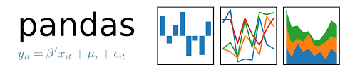







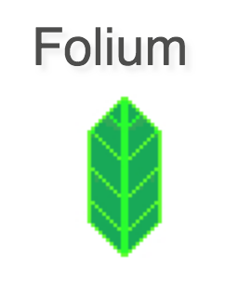



Python World

Slide 3
About me
I am an IPS Officer. Did engineering from Punjab Engineering College Chandigarh
Recently wrote a book on Python:- Python Programming: Problem solving, Packages (McGraw Hill). Available on Amazon.in at:- https://www.amazon.in/Python-Programming-Problem-Packages-Libraries/dp/9353168007/ref=sr_1_1?dchild=1&qid=1609224326&refinements=p_27%3AGupta+Biswas&s=books&sr=1-1
Mail:- 999.anuraggupta@gmail.com , GitHub:- https://github.com/ag999git
I occasionally write for an online magazine https://opensource.com/. My three recently published articles on spread on Covid 19 are at
https://opensource.com/article/20/4/python-map-covid-19
https://opensource.com/article/20/4/python-data-covid-19 and
https://opensource.com/article/20/5/duck-typing-python
I also write for a print/ Online Magazine called OpenSourceForU. My two articles published in this magazine are available at:-
Creating a Very Basic Chatbot in Python on Telegram Messenger:- https://github.com/ag999git/articles-talks/blob/master/23_Telegram%20Bot_OSFY%20August%202020.pdf
Visualisation Versus Summary Statistics: The Lesson from Anscombe’s Quartet:- https://github.com/ag999git/articles-talks/blob/master/Anscombes-quartets-OSYU-Dec2020.pdf
Plotting Air Quality Index Data on a Map Using Python (Upcoming in January 2021 issue):- https://github.com/ag999git/articles-talks/blob/master/11_Plotting%20with%20python_OSFY-January2021-Final.pdf

Slide 4
Brief description about my book
The book has 25 chapters.
20 chapters are in the printed form of the book
Rest of the 5 are available online
I have made extensive power point presentations and also Jupyter notebooks (in HTML) format. All these are available on my GitHub page in the following repository:- https://github.com/ag999git/Book-Python-Programming-Problem-Solving-Packages-and-Libraries
The best way to use this material is to clone the repository (Or if you don’t know/ don’t use clone, then you can also download the files using GitHub Desktop)

Slide 5
OUTLINE OF THIS TALK
Very brief introduction to Machine Learning (ML) through the library Scikit-Learn
Some basic skills desirable for ML
Brief introduction of the Open Source Movement
Popularity of Python as a Programming Language
The Positives (and the Negatives) of Python
Comparison and Alternatives to Python
Basics of Python (Just an overview)
Why You Should Use:- Jupyter Notebook/ Anaconda Distribution
Numpy/Scipy:- A brief overview
Pandas:- A brief overview
Vector Space Models and Gensim (For topic modeling):- A brief overview
GitHub:- Why you should use it
Open source movement

Slide 6
WHAT IS MACHINE LEARNING (ML)?
Wikipedia (https://en.wikipedia.org/wiki/Machine_learning )
Machine learning (ML) is the study of computer algorithms that improve automatically through experience.
It is seen as a subset of artificial intelligence.
Machine learning algorithms build a model based on sample data, known as "training data", in order to make predictions or decisions without being explicitly programmed to do so.
Machine learning algorithms are used in a wide variety of applications, such as email filtering and computer vision, where it is difficult or unfeasible to develop conventional algorithms to perform the needed tasks.

Slide 7
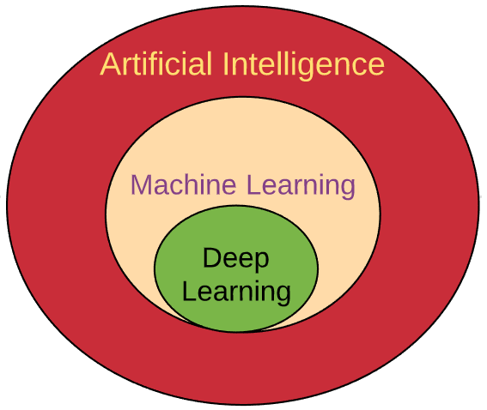
Deep Learning Vs Machine Learning Vs Artificial Intelligence

Slide 8
Deep Learning Vs Machine Learning
Issue | Machine Learning (ML) | Deep Learning (DL)
Relationships | ML is a sub-set of Artificial Intelligence (AI) | DL is a sub-set of ML
Problem solving approach - 1 | Break up the problem into smaller parts and try to solve the parts | Solve the problem as a whole
Problem solving approach - 2 | Machine learning uses algorithms to parse data, learn from that data, and make informed decisions based on what it has learned | Deep learning structures algorithms in layers to create an "artificial neural network” that can learn and make intelligent decisions on its own
Feature extraction/ Feature engineering | By human intervention | The system tries to identify features on its own
Dependence on Data | Can perform with small data sets. Say thousands of data points | Tend to preform better with large data sets. Say millions of data Points
Hardware | ML generally requires less hardware than DL | More hardware needed
Time | Less | More

Slide 9
Machine Learning – the beginning
Early examples of ML
OCR:- Optical Character Recognition
Spam Filter

Slide 10
Machine Learning
Machine Learning
Unsupervised
Supervised
Reinforcement learning

Slide 11
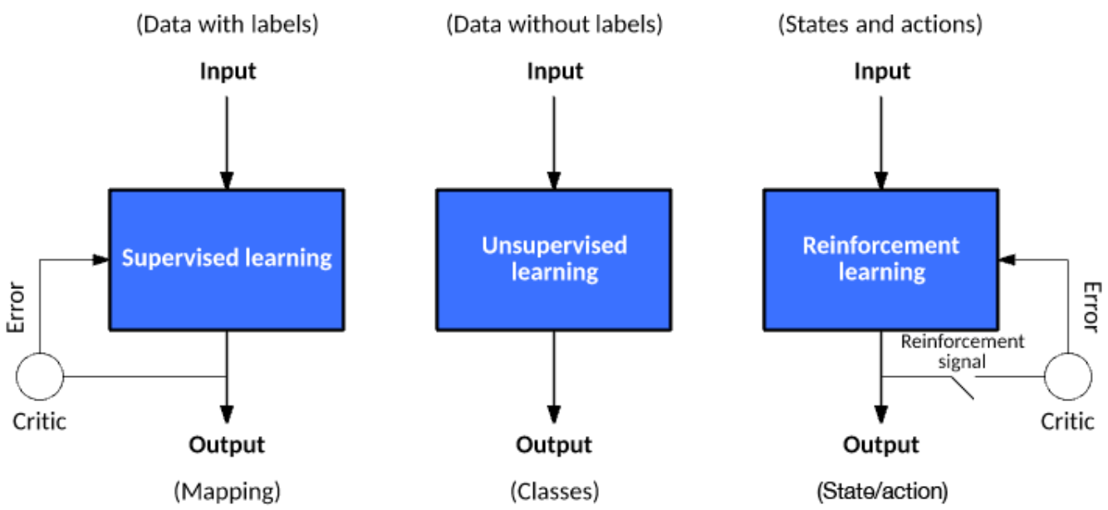
Types of Machine Learning Algorithms
Above image is taken from:- https://developer.ibm.com/technologies/artificial-intelligence/articles/cc-models-machine-learning/

Slide 12
Types of Machine Learning Algorithms
In supervised learning
a data set includes its desired outputs (or labels) such that a function can calculate an error for a given prediction.
The supervision comes when a prediction is made and an error produced (actual vs. desired) to alter the function and learn the mapping.
In unsupervised learning
a data set doesn’t include a desired output;
therefore, there’s no way to supervise the function.
Instead, the function attempts to segment the data set into “classes” so that each class contains a portion of the data set with common features.
In reinforcement learning
the algorithm attempts to learn actions for a given set of states that lead to a goal state.
An error is provided not after each example (as is the case for supervised learning) but instead on receipt of a reinforcement signal (such as reaching the goal state).
This behavior is similar to human learning, where feedback isn’t necessarily provided for all actions but when a reward is warranted.
Taken from:- https://developer.ibm.com/technologies/artificial-intelligence/articles/cc-models-machine-learning/

Slide 13
Classification of Supervised Learning Algorithms
Supervised
Classification
Regression

Slide 14
CLASSIFICATION ALGORITHMS
Classification Algorithms
Logistic Regression
K-Nearest Neighbours
Support Vector Machines
Kernel SVM
Naïve Bayes
Decision Tree Classification
Random Forest Classification

Slide 15
REGRESSION ALGORITHMS
Regression Algorithms
K-Nearest Neighbours
Simple Linear Regression
Multiple Linear Regression
Polynomial Regression
Support Vector Regression
Decision Tree Regression
Random Forest Regression

Slide 16
Classification Vs Regression
Classification Algorithm | Regression Algorithm
Output must be a discrete value (Label) | Output must be a continuous value.
The algorithms map a input value (say x) to a discrete or “categorical” value (say y) | The algorithms map a input value (say x) to a “continuous” or “real” value (say y)
In Classification, we try to find the decision boundary, which can divide the dataset into different classes. | In Regression, we try to find the best fit line, which can predict the output more accurately.
Classification Algorithms can be used to solve classification problems such as Identification of spam emails, Speech Recognition, Identification of cancer cells, etc. | Regression algorithms can be used to solve the regression problems such as Weather Prediction, House price prediction, etc.
The Classification algorithms can be divided into Binary Classifier and Multi-class Classifier. | The regression Algorithm can be further divided into Linear and Non-linear Regression.

Slide 17
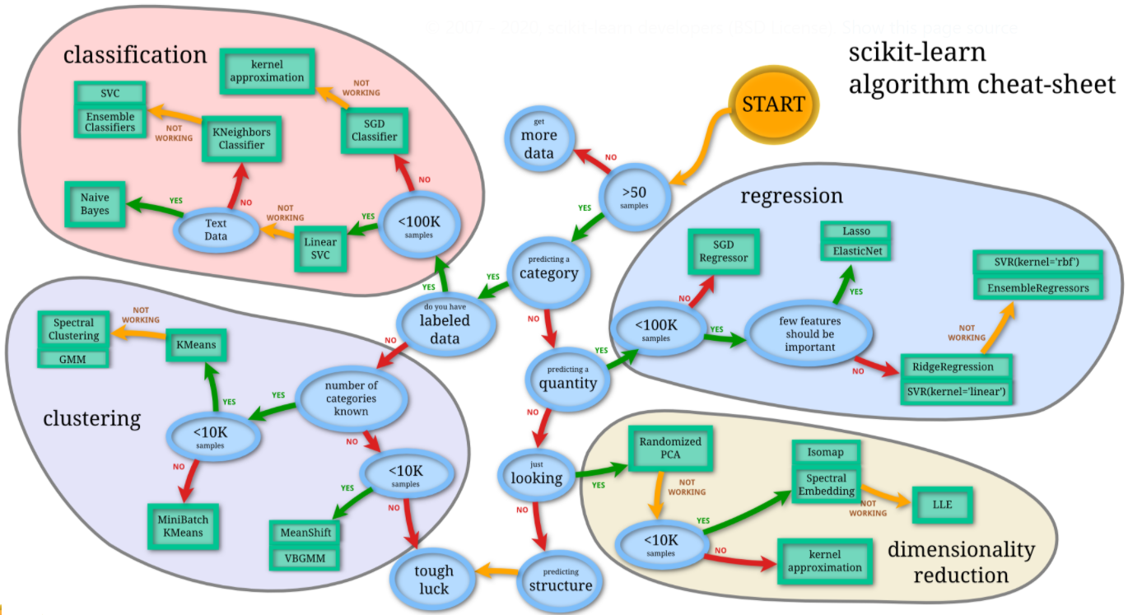
Scikit-learn Algorithm cheat-sheet
Taken from:- https://scikit-learn.org/stable/tutorial/machine_learning_map/

Slide 18
Scikit-Learn Uses a number of other Python libraries
Scikit-learn
NumPy: Base n-dimensional array package
SciPy: Fundamental library for scientific computing
Matplotlib: Comprehensive 2D/3D plotting
IPython: Enhanced interactive console
Sympy: Symbolic mathematics
Pandas: Data structures and analysis

Slide 19
SOME BASIC SKILLS DESIRABLE IN MACHINE LEARNING

Slide 20
General Concepts about programming
Difference between scripted and compiled languages
Difference between statically typed/ duck typed and type hints
Strongly typed versus weakly typed.
Casting (Implicit and explicit)
Passing by reference and passing by value
Object oriented Programming concepts
Errors and how to handle them

Slide 21
Basics of Python (Desirable for ML)
Installing Python
Installing Anaconda/ Jupyter notebooks
Using pip/ conda to install Python libraries
Understanding concept of Virtual Environment
Operators in Python
Built in data types:- Strings, Lists, Dictionaries, Tuples etc
Functions basics
Understand concepts of function arguments (default arguments, positional arguments and keyword arguments)
Understanding flow control, Conditional statements, loops
Object Oriented Programming in Python
Inheritance and Namespace
File operations in Python
Python Exceptions

Slide 22
Some common terms in ML
ML Algorithm:- In machine learning (ML) an “Algorithm” is a procedure that is run on data to create a machine learning “model.”
Modeling:- What is a model? It’s simply a specification of a mathematical (or probabilistic) relationship that exists between different variables.
Difference between an Algorithm and a Model
Mean Squared Error:- (The Wikipedia page:- https://en.wikipedia.org/wiki/Mean_squared_error )
Cost Function:- It is a function that measures the performance of a Machine Learning model for given data. Cost Function quantifies the error between predicted values and expected values and presents it in the form of a single real number. The purpose of Cost Function is to be either Mimimizing or maximizing.
Minimizing the Cost Function:- Gradient Descent
Gradient Descent:- Optimizing the Weights
Anomaly/ anomalies
Overfitting And underfitting:- The bias-variance trade-off.
Accuracy of the model
True Positives
False Positives
True Negatives
False Negatives
Test/ Train split

Slide 23
A typical ML task
Installing Python and ML libraries.
Getting a dataset.
Cleaning the data set.
Summarizing the dataset.
Visualizing the dataset.
Evaluating some algorithms.
Making some predictions.

Slide 24
Common Python libraries for Visualization and Machine Learning
Libraries for Visualization
Cartopy
Folium:- Folium makes it easy to visualize data on an interactive leaflet map. The library has a number of built-in tilesets from OpenStreetMap, Mapbox, and Stamen
Matplotlib:- Most common 2D plotting library. Can plot almost anything but complex to use.
Seaborn:- Seaborn is a Python data visualization library based on Matplotlib. It provides a higher-level wrapper on the library which makes it easier to use.
Plotly:- Plotly’s Python graphing library makes it easy to create interactive, publication-quality graphs.
Libraries for Machine learning
Numpy and Scipy
Scikit-Learn
Pandas
Theano
TensorFlow
Keras
PyTorch

Slide 25
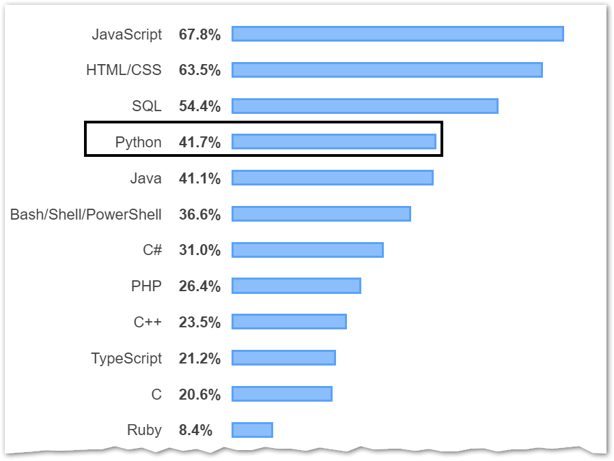
The growing popularity of Python (Stackoverflow survey 2019)
For the seventh year in a row, JavaScript is the most commonly used programming language, but Python has risen in the ranks again.
This year, Python just edged out Java in overall ranking, much like it surpassed C# last year and PHP the year before.
Python is the fastest-growing major programming language today.
Source:- https://insights.stackoverflow.com/survey/2019

Slide 26
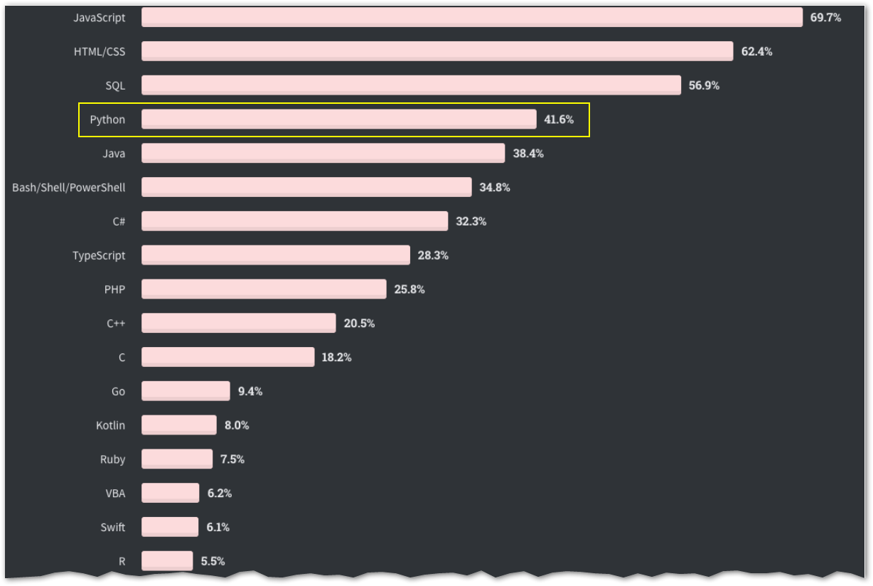
The growing popularity of Python (Stackoverflow survey 2020)
JavaScript has been the most-used technology since Stack Overflow started doing the annual survey.
Dart seems to be growing with the introduction of Flutter for mobile app development.
Kotlin has grown pretty quickly as an alternative for Java development.
And Python seems to be as healthy as ever.
Source:- https://www.freecodecamp.org/news/stack-overflow-developer-survey-2020-programming-language-framework-salary-data/

Slide 27
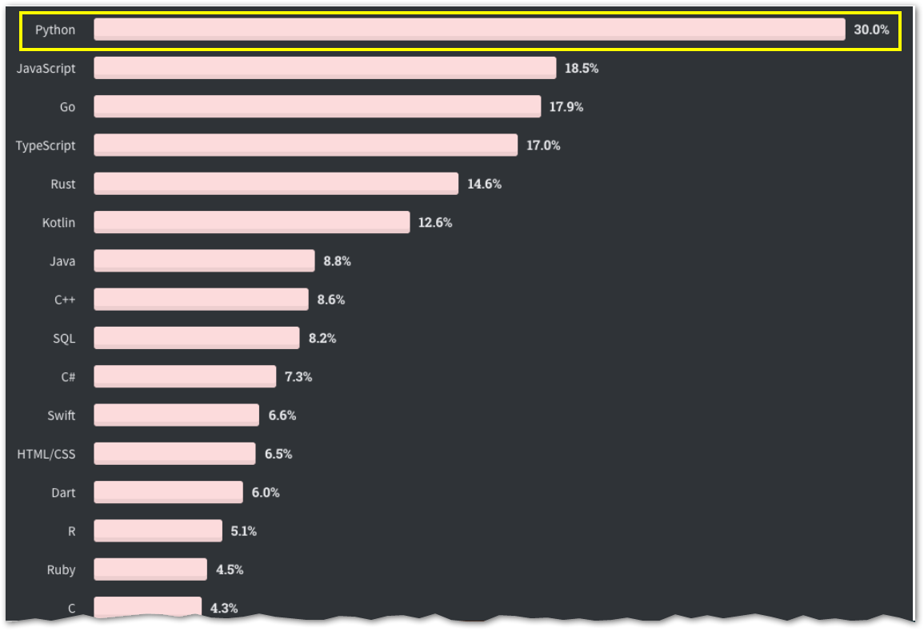
The programming language Developers want to learn next
(Stackoverflow survey 2020)
Developers who are already working with other programming languages are most interested in learning Python, JavaScript, Go, and TypeScript.
Source:- https://www.freecodecamp.org/news/stack-overflow-developer-survey-2020-programming-language-framework-salary-data/

Slide 28
Why Python as a Programming Language is a good idea
Simple logical syntax (You can do more with less)
Easy to learn
Scripted, dynamically typed
Open source and free
Thousands of libraries
Huge community

Slide 29
Python good for
Web Server Programming: Developers can perform server-side programming through Python libraries like Django and Flask.
Prototyping: Through Python, developers can create quick prototypes to present to the client.
Game development: It is widely used in the development of games, including GUI, through libraries like PyGame.
Data science and machine learning: Python is the best and most commonly used language for machine learning and data science. It has a great community and vast range of libraries. It has libraries available for data manipulation, data visualization, data cleaning, and several other related functionalities.

Slide 30
Where Python is not such a good idea
Scalability
Speed
Mobile apps
Web front end rather than back end
Not good for multi-threading
May be difficult to maintain for very large projects
Errors and bugs in dynamically typed languages may be hard to catch

Slide 31
Why not Python/ Who is it probably not for
Speed:- Python is slow compared to compiled languages.
White spaces:- Python uses white spaces for line indentation while others like C++, use braces and semicolons. White space indentation are more “visually appealing” but using braces makes the code more “maintainable” which is important for big projects.
Mobile apps:- Python is not native to the mobile environment to either iOS or Android. So it is difficult though possible to develop mobile Apps in Python. Java, on the other hand, is preferred for Android app development.
Runtime Errors:- Since Python scripts are not compiled, so all errors (even syntax errors) occur at run time. So Python requires lots of testing.
Large Memory Consumption:- Python's structures demand more memory space. This language is not suitable to use for development under limited memory restrictions.

Slide 32
A brief note about JavaScript
JavaScript is a client-side scripting language.
It allows you to implement complex features on web pages
Browsers have built-in engines that understand and execute JavaScript commands. Therefore, you can include the JavaScript code directly into your HTML document.
After Node.js emerged as a backend language in 2009, the popularity of JavaScript shot up as developers could use JavaScript to program both the front-end and the server-side.

Slide 33
Python vs JavaScript
S No | Parameter | Python | JavaScript | Comment
1 | Easy to learn | Easy | Harder
2 | Scalability | Not so much | Node.js is highly scalable | Node.js is designed for scalability/ asynchronous programming
3 | In web development | Mostly backend | Both front end and back end | With Node.js, backend development in JavaScript is very easy
4 | Other areas | Machine Learning (ML), Data Analytics, AI, | JavaScript also has a number of very popular libraries like Jquery, D3.js, React.js | But JavaScript libraries are basically focused towards the web
5 | Speed | Slower | Slower than compiled languages, but faster than Python | Because of Chrome’s V8 which is one of the fastest engines

Slide 34
New kids on the block
Julia:- It was started by 4 persons in 2009. Specifically for scientific computing, machine learning, data mining, large-scale linear algebra, distributed and parallel computing. It is fast, easy to learn and use, and open source
Go:- also known as Golang, is a programming language developed by Google. Go provides excellent support for multithreading
Rust:- Developed by Mozilla. Microsoft is trying to use the Rust programming language instead of C and C++ to write and code the components of Windows. The project is known as Verona.
Swift:- Apple introduced Swift to replace Objective C for Mac and iPhone
Kotlin:- Google supports Kotlin, for designing Android apps as an alternative to Java.
Typescript:- TypeScript is a typed superset of JavaScript that compiles to plain JavaScript. TypeScript is pure object oriented with classes, interfaces and statically typed like C# or Java. The popular JavaScript framework Angular 2.0 is written in TypeScript
Old traditional languages which are still hugely popular like Java, C/ C++, JavaScript, PHP are not included here

Slide 35
Some good resources to learn Python
There is an excellent Python FAQ at:- https://docs.python.org/3/faq/general.html
One great place to see some great Jupyter notebooks is:- https://github.com/jupyter/jupyter/wiki/A-gallery-of-interesting-Jupyter-Notebooks

Slide 36
The ZEN of Python
Beautiful is better than ugly.
Explicit is better than implicit.
Simple is better than complex.
Complex is better than complicated.
Flat is better than nested.
Sparse is better than dense.
Readability counts.
Special cases aren't special enough to break the rules.
Although practicality beats purity.
Errors should never pass silently.
Unless explicitly silenced.
In the face of ambiguity, refuse the temptation to guess.
There should be one-- and preferably only one --obvious way to do it.
Although that way may not be obvious at first unless you're Dutch.
Now is better than never.
Although never is often better than *right* now.
If the implementation is hard to explain, it's a bad idea.
If the implementation is easy to explain, it may be a good idea.
Namespaces are one honking great idea -- let's do more of those!

Slide 37
BASICS OF
PYTHON

Slide 38
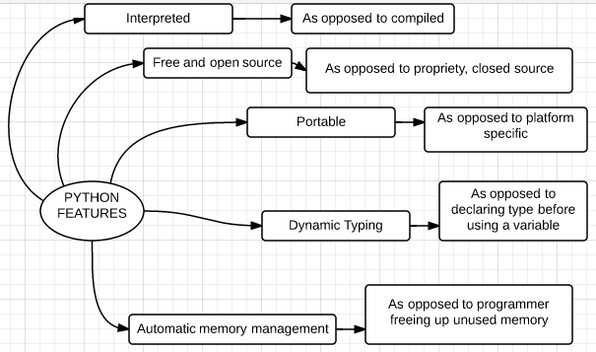
Python major features

Slide 39
Compiler versus interpreter
Python is a “high level” language.
To translate these “high level” programs into machine readable form, two types of programs are used. They are:- interpreters and compilers:-
An interpreter reads a high-level program and executes it, one statement at a time.
A compiler on the other hand reads the entire program (Also called “source code”) and first converts into a “machine readable” form (Also called “object code”). It then “executes” the entire translated program ie the object code in one go.

Slide 40
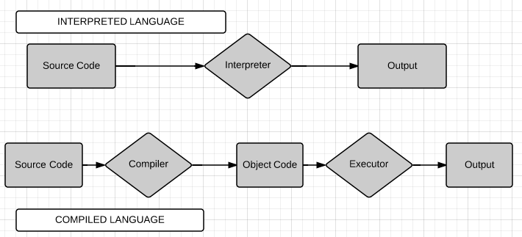
Interpreted VS Compiled language

Slide 41
PORTABLE
Portability, in relation to software, indicates how easily an application can be transferred from one computer environment to another.
Standard Python is written in portable ANSI C. It can compiles and runs on all major operating systemslike Windiws, Linux, Unix and Mac.

Slide 42
DYNAMIC TYPING OR DYNAMIC BINDING
The analogy of a “box” vs a “tag”
Please note that in strongly-typed languages, such as C++, each variable has a type which has to be declared before the variable name can be used.
You can think of an analogy of a box. In C++ there are different types of boxes for storing different types of objects, just like in a shop there may be different types of boxes for storing say shoes or storing matches.
So, in C++ a variable name is like a box and each type of box is different.
This is in contrast to the variable names in Python, where, a variable name can be compared to a “price tag”. So the same “tag” can be used on a shoe or a match.
The tag is ‘tied’ to an object.
If you ask for a “type” of such a tag or a variable in Python, you are not getting the ‘type’ of the tag. Rather, you are getting the ‘type’ of the object to which the tag is tied.

Slide 43
Automatic memory management
The Python interpreter does automatic memory management by allocating memory when objects are created and reclaiming it when objects are no longer in use.
It does this through “garbage collection”.
Java also has garbage collector
But C does not have garbage collector. So in C, you have to explicitly free the memory yourself, or else there will be “memory leak”

Slide 44
Using Python Interactive mode as a calculator
You can use the Python interpreter as a calculator.
As you type in mathematical expressions, results are displayed on pressing “return”.
The operators +, -, * and / (For addition, subtraction, multiplication and division) work just like in many popular programming languages.
You can use parenthesis ie “()” for grouping.
Hash ie # is used for single line comments and totally ignored by the Python interpreter.

Slide 45
WHY YOU SHOULD USE:-
JUPYTER NOTEBOOK/ ANACONDA DISTRIBUTION

Slide 46
The “philosophy” behind Jupyter notebooks
Literate computing (versus Literate programming):-
Donald Knuth proposed literate programming in the early 1980s.
Literate programming has been most commonly adopted when the desired final document is intend primarily for human consumption. Few, if any, large software libraries are written this way. In fact, the most prevalent use of literate programming has been among scientists to communicate computational ideas and results to one another.
Literate computing (Proposed by Fernando Perez):- interactive environments where the user can enter code for immediate execution, obtain results, and continue with more commands that produce new results based on the previous ones.
A literate computing environment is one that allows users not only to execute commands but also to store in a literate document format the results of these commands along with figures and free-form text that can include formatted mathematical expressions.

Slide 47
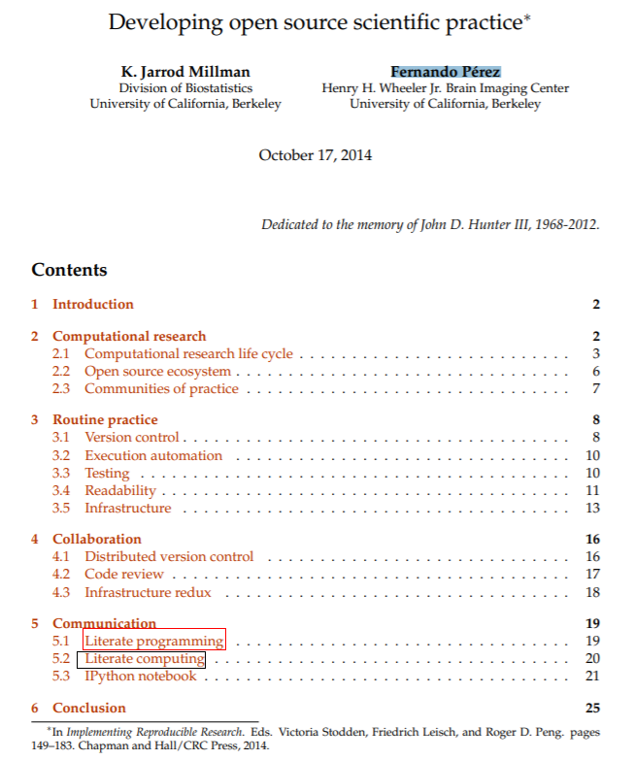
The “philosophy” behind Jupyter notebooks – Further reading
Screen shot of the paper
Those interested in further reading on the subject above can read The historic and influential paper:- http://www.jarrodmillman.com/publications/millman2014developing.pdf
(Especially read Sections 5.1 and 5.2 )

Slide 48
IPython, Anaconda and Conda
The traditional method to learn Python was to use the IDLE python interpreter.
However in 2001, an important variation of Python interactive shell was developed called IPython.
In 2014, a project called Jupyter notebook was started. This project provides a way of running python scripts in a web browser using a server on local machine.

Slide 49
Why use Jupyter Notebooks?
Everything together:- You can have your description (in Markdown cells), code and its output at one place. Further the Markdown can contain text, equations, figures, graphs and videos etc. So you can design the learning environments and experiences.
Can run your code in parts:- So you can interspace code cells with Markdown cells to explain each block of code.
Support:- Jupyter supports over 40 programming languages, including Python, R, Julia, and Scala.
Easy installation
Interactive output:- Your code can produce rich, interactive output: HTML, images, videos, LaTeX, and custom MIME types.
Share notebooks:- Notebooks can be shared with others using email, Dropbox, GitHub and the Jupyter Notebook Viewer.
Big data integration:- Leverage big data tools, such as Apache Spark, from Python, R and Scala. Explore that same data with pandas, scikit-learn, ggplot2, TensorFlow.

Slide 50
Why use Anaconda?
The anaconda package is very easy to install. You can install the entire Python interpreter along with more than 200 libraries for scientific computing with a single click.
The user interface of IPython and Jupyter notebook is much better than of IDLE.
Jupyter and IPython have become the virtual standards for teaching machine learning in almost all major universities all over the world.
Jupyter also provides integration with many other programming languages (Like language R for statistics).
For details See:- https://jupyter.org/

Slide 51
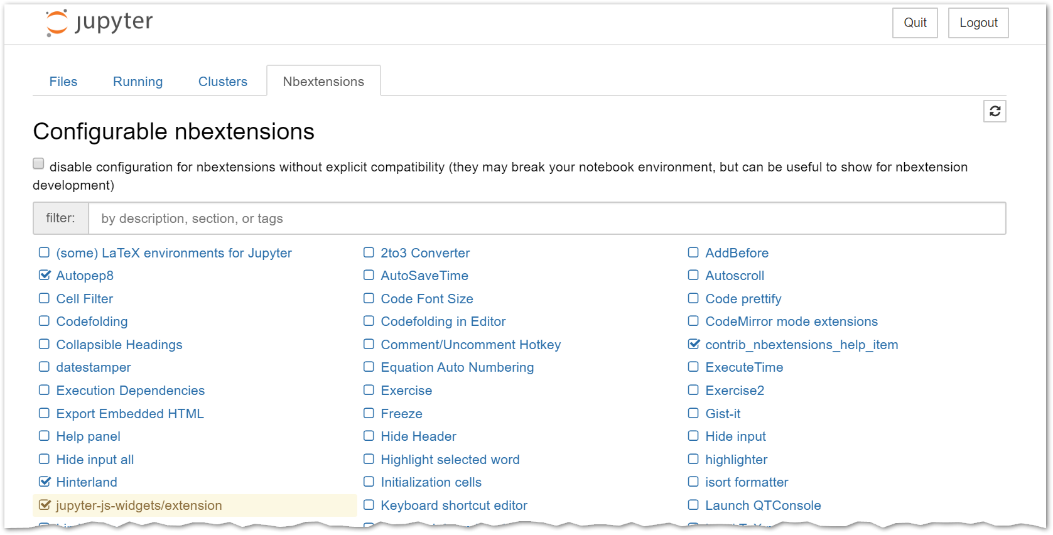
Jupyter Notebook extensions
The following repository has collection of extensions to add functionality to the Jupyter notebook :- https://github.com/ipython-contrib/jupyter_contrib_nbextensions

Slide 52
Jupyter Notebook as a client-server application
One needs to run a server(Jupyter server in this case).
The server may be run either on the local machine or on remote machine.
Once the server is started, it will in turn open a web browser page which will be the client of the server.
So the Jupyter notebook client will run in a web browser like Chrome or firefox.
The code that you enter in the web client will be sent by the web client to the server and will be executed by the server and the result displayed on the client (ie the browser).

Slide 53
NUMPY SCIPY
The complete PPT on Numpy/ Scipy is available at:-
https://github.com/ag999git/Book-Python-Programming-Problem-Solving-Packages-and-Libraries/blob/master/PPT-notes-as-pdf/Ch-18-Numpy-Scipy.pdf
Python Programming: Problem Solving, Packages and Libraries

Slide 54
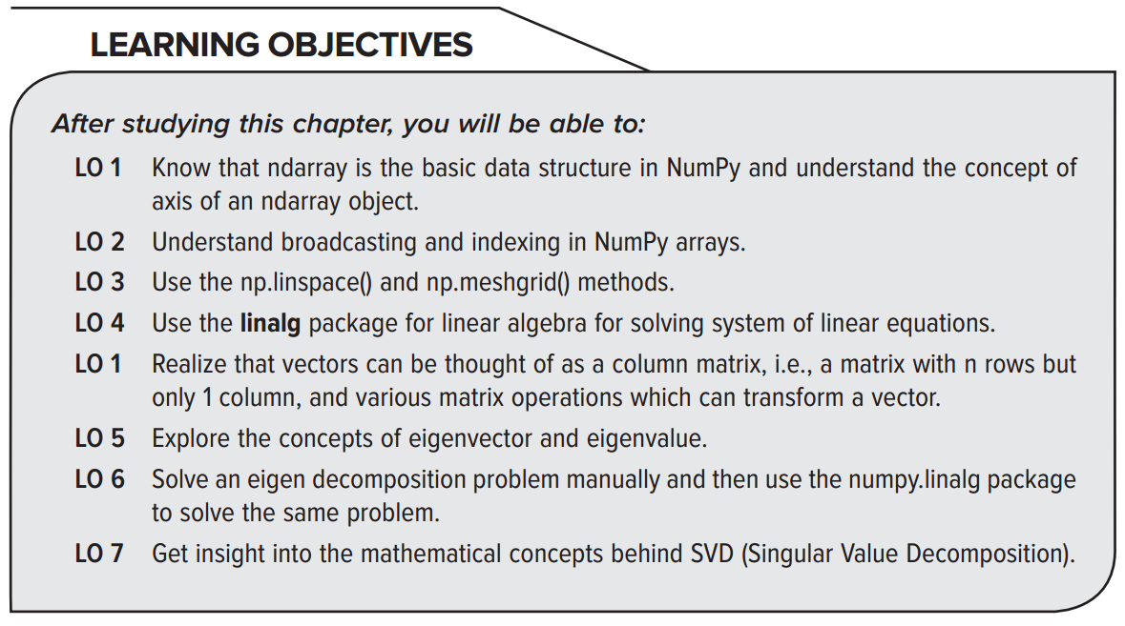
Chapter 18 NumPy, SciPy
Python Programming: Problem Solving, Packages and Libraries

Slide 55
N-dimensional array in NumPy
The main data structure defined and used in NumPy module is called ndarray. The term ndarray stands for N-dimensional array. An object of type ndarray represents a multi-dimensional array of data.
The use of NumPy will become clear from the following script:
1 2 3 4 5 6 7 8 9 | import numpy as np A = [ n * n for n in range(20)] B = np.array(A) print(B) C = B * 2 #You cant do this in Python but you can in numpy print(C) import matplotlib.pyplot as plt plt.plot(C) plt.show()
The above script is explained in details in the book
Python Programming: Problem Solving, Packages and Libraries

Slide 56
Some of the common methods in NumPy --1
1. numpy.array(alist), where alist is a python list: It is a function to create a NumPy array which is of type ndarray. Note that in pure Python there are only lists and there is no data type called ndarray. But NumPy has a large number of its own data types. Note that numpy.array() is a method and the object created by this method is ndarray
2. numpy.zeros(N, M, dtype = float): This constructs an n-dimensional array of the specified shape, i.e., N  M, filled with zeros of the specified dtype.
3. numpy.ones(N, M, dtype=float): This constructs an 2-dimensional array of the specified shape, i.e., N  M, filled with ones of the specified dtype.
Python Programming: Problem Solving, Packages and Libraries

Slide 57
Some of the common methods in NumPy --2
4. numpy.eye(N, M = None, dtype=float): This returns a two-dimensional (2D) array which has number 1 on the diagonal elements and number 0 everywhere else. By default the data type, i.e., the 0s and the 1s are floats. Note if value of M is not specified, it will be same as N and the resulting matrix will be a square matrix. But if M is different from N then it will not be a square matrix.
5. numpy.transpose(a, axes=None): This method permutes the dimensions of the given array, i.e., “a”. Note that the parameter a is an array, whose transpose is to be created. You have the option of not specifying any value for axis. If no value is given, then the default value for axes is None and the dimensions get reversed. The other options for axis are not discussed here. You can always look up the online documentation for details. However, note that the axes are passed as a tuple of integers starting from 0 since the 1st axes will have a dimension number of 0. In its simplest form, if you create the transpose of a 2D matrix say of type 2  5, then its transpose will be a matrix of type 5  2.
Python Programming: Problem Solving, Packages and Libraries

Slide 58
Some of the common methods in NumPy --3
6. numpy.arange(start, stop, increment): NumPy method arrange() is like the Python range function but with one important difference. In the arrange method, the values for start, stop and step can be real values (not just integers like in ordinary Python), i.e., can be decimals and fractions also.
7. numpy.random.random((N, M)): This will create a NumPy array N  M filled with random numbers in range [0,1). Note 1 is not generated but 0 can be generated.
8. numpy.random.randint(X, Y, (N, M)): Here X and Y must be integers and so random integers will be generated between [X, Y), i.e., from X to Y but not including Y. N  M are the dimensions of the array created.
Python Programming: Problem Solving, Packages and Libraries

Slide 59
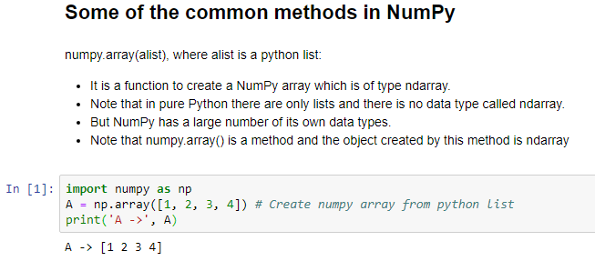
Given below are the screen shots of Jupyter notebook of the common methods of numpy discussed before. (The screen shots given below are from a Jupyter workbook which can also be downloaded)
Python Programming: Problem Solving, Packages and Libraries

Slide 60
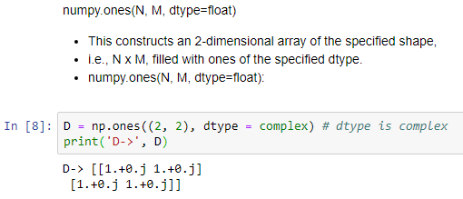
Method numpy.ones()
Python Programming: Problem Solving, Packages and Libraries

Slide 61
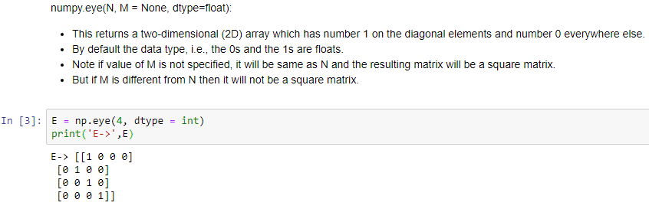
Method numpy.eye()
Python Programming: Problem Solving, Packages and Libraries

Slide 62
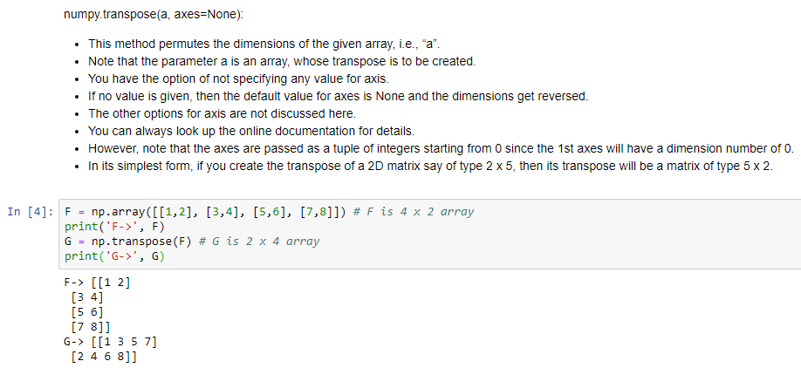
Method numpy.transpose()
Python Programming: Problem Solving, Packages and Libraries

Slide 63
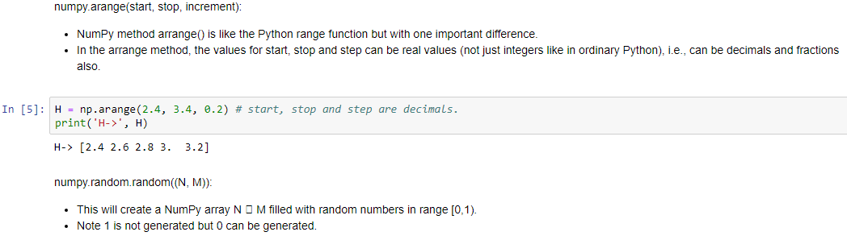
Method numpy.arrange()
Python Programming: Problem Solving, Packages and Libraries

Slide 64
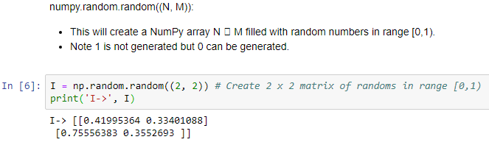
Method numpy.random.random()
Python Programming: Problem Solving, Packages and Libraries

Slide 65
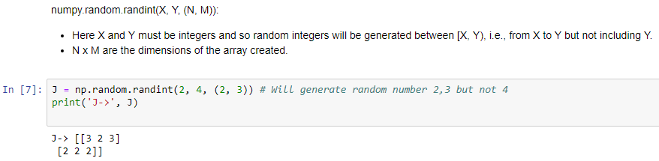
Method numpy.random.randint()
Python Programming: Problem Solving, Packages and Libraries

Slide 66
Common numpy methods discussed above are given at one place in the script below
1 2 3 4 5 6 7 8 9 10 11 12 13 14 15 16 17 18 19 20 21 | import numpy as np A = np.array([1, 2, 3, 4]) # Create numpy array from python list print('A ->', A) B = np.zeros((2, 2)) # Data type defaults to float print('B->', B) C = np.zeros((2,2), dtype = int) # Data type is int, so no decimal after 0 print('C->', C) D = np.ones((2, 2), dtype = complex) # dtype is complex print('D->', D) E = np.eye(4, dtype = int) print('E->',E) F = np.array([[1,2], [3,4], [5,6], [7,8]]) # F is 4 x 2 array print('F->', F) G = np.transpose(F) # G is 2 x 4 array print('G->', G) H = np.arange(2.4, 3.4, 0.2) # start, stop and step are decimals. print('H->', H) I = np.random.random((2, 2)) # Create 2 x 2 matrix of randoms in range [0,1) print('I->', I) J = np.random.randint(2, 4, (2, 3)) # Will generate random number 2,3 but not 4 print('J->', J)
The output from this script is shown on next slide
Python Programming: Problem Solving, Packages and Libraries

Slide 67
Output of script from previous page
22 23 24 25 26 27 28 29 30 31 32 33 34 35 36 37 38 39 40 41 42 43 44 | # Output is A -> [1234] B-> [[ 0.0.] [ 0.0.]] C-> [[00] [00]] D-> [[ 1.+0.j 1.+0.j] [ 1.+0.j 1.+0.j]] E-> [[1000] [0100] [0010] [0001]] F-> [[12] [34] [56] [78]] G-> [[1357] [2468]] H-> [ 2.42.62.83.3.2] I->[[ 0.30554412 0.98019027] [ 0.11167242 0.96397391]] J-> [[232] [232]]
Python Programming: Problem Solving, Packages and Libraries

Slide 68
Concept of dimensions in a Numpy array
The concept of dimensions of an array in NumPy will become clear from the following example. As an example, take a 2 × 3 × 4 array. It will have a total of 24 items in it. Fill it up with integers from 0 to 23. The code is as follows:
1 2 3 | import numpy as np A = np.arange(24).reshape(2,3,4) print(A)
4 5 6 7 8 9 10 11 | # Output [[[ 0 1 2 3] [ 4 5 6 7] [ 8 9 10 11]] [[12 13 14 15] [16 17 18 19] [20 21 22 23]]]
You can think of (1) Dimension 0 as sheet; (2) Dimension 1 as row; and (3) Dimension 2 as column.
The next slide shows a geometric representation of this 3-D array
Python Programming: Problem Solving, Packages and Libraries

Slide 69
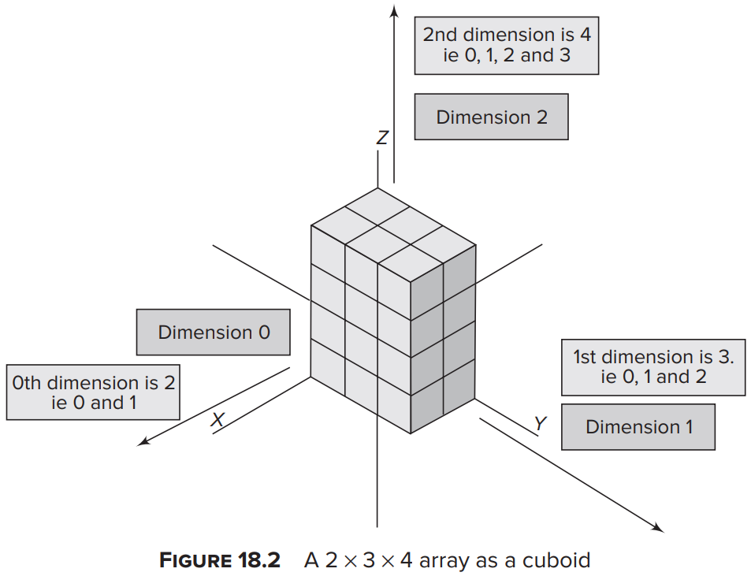
Concept of dimensions in a Numpy array (Geometric representation of a 3-D ndarray)
Python Programming: Problem Solving, Packages and Libraries

Slide 70
Element-wise operations on arrays
In the NumPy package:-
a number of methods are provided for doing operations on the individual elements of the array.
For example, numpy.sum(a) will add all the elements of an array and give the result.
1 2 3 4 5 6 7 | import numpy as np A = np.arange(12).reshape(3, 4) # Create 3 x 4 array print("A=",A) B = A.sum(axis = 0) # Add along axis 0 print("B=",B) C = A.sum(axis = 1) # Add along axis 1 print("C=", C)
8 9 10 11 12 13 | # Output A= [[ 0123] [ 4567] [ 891011]] B= [12151821] C= [ 62238]
Python Programming: Problem Solving, Packages and Libraries

Slide 71
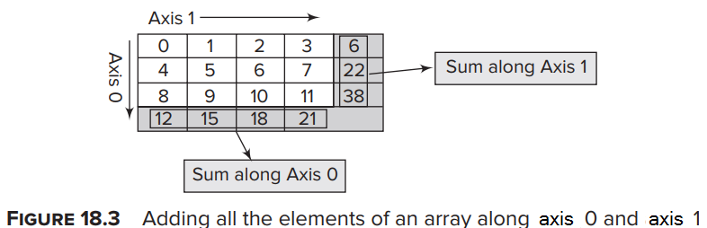
Figure showing:- Element-wise operations on a numpy array
Python Programming: Problem Solving, Packages and Libraries

Slide 72
Broadcasting in NumPy array operations
In NumPy array operations, the term broadcasting comes into play when you do arithmetic operations on arrays with different shapes.
In normal Python arrays like lists, mathematical operations are done on arrays of same shape.
However, in NumPy, under certain circumstances, it is possible to do some mathematical operations on arrays of different lengths. The way this is done is to broadcast the smaller array into an array of larger dimension.
Python Programming: Problem Solving, Packages and Libraries

Slide 73
Python arrays (Lists) and Numpy arrays behave differently
However considering broadcasting, you need to understand that Python arrays and NumPy arrays behave differently.
The following example shows the difference in behavior of Python array (i.e. list) and NumPy array:
1 2 3 4 5 6 7 8 9 10 | import numpy as np # In Python myL = [1, 2, 3, 4] expand = 2 expandedL = myL * 2 print('in python->', expandedL) # In numpy a = np.array(myL) expanded_a = a * expand print('in numpy->', expanded_a)
11 12 13 | # OUTPUT in python-> [1, 2, 3, 4, 1, 2, 3, 4] in numpy-> [2 4 6 8]
Python Programming: Problem Solving, Packages and Libraries

Slide 74
Certain other aspects of broadcasting (Not covered in details in the book)
The following aspects of broadcasting are relevant:
NumPy operations are usually done on 2 ndarrays on an element-by-element basis.
This means that suppose you have 2 ndarray say A and B of dimensions 2 x 3 each, then A + B would lead to the corresponding elements being added.
However NumPy also permits mathematical operations on arrays of “different dimensions”, with certain restrictions.
This means that it is possible to do mathematical operations on ndarray of different dimensions provided they obey certain restrictions.
So subject to certain constraints, the smaller array is “broadcast” across the larger array so that they have compatible shapes.
Python Programming: Problem Solving, Packages and Libraries

Slide 75
Broadcasting of a “scalar” -- 1
The simplest broadcasting is when an array and a “scalar” are combined in an operation.
A “scalar” here means simply a number.
The scalar is “converted” into an array of same dimension as the array on which it is being operated and each element in this “converted array” is a copy of the scalar.
Python Programming: Problem Solving, Packages and Libraries

Slide 76
Broadcasting of a “scalar” – 2 (Example)
1 2 3 4 5 | import numpy as np A = np.arange(12).reshape(3, 4) # Create 3 x 4 array print(A) scalar = 5 print(A * scalar)
6 7 8 9 10 11 12 | # Output [[ 0 1 2 3] [ 4 5 6 7] [ 8 9 10 11]] [[ 0 5 10 15] [20 25 30 35] [40 45 50 55]]
Python Programming: Problem Solving, Packages and Libraries

Slide 77
The rules for broadcasting -- 1
The two arrays have exactly the same shape. (Here of course no broadcasting is required)
The two arrays have the same number of dimensions but the sizes of some or all of the dimensions are different.
For example you have 2 arrays of dimensions 2 x 3 x 4 and 2 x 3 x 1. These 2 arrays both have 3 dimensions out of which the first 2 dimensions are of same size but the third dimension is of different size.
The rule for broadcasting here is that the “uncommon” dimensions should be 1. So for example if you have two 3-D arrays say A → 2 x 3 x 4 and B → 2 x 3 x 1, then array B can be broadcast into 2 x 3 x 4 array because its uncommon dimension has a size of 1.
[Continued on next slide . . . .]
Python Programming: Problem Solving, Packages and Libraries

Slide 78
The rules for broadcasting -- 2
[… Continued from previous slide]
The 2 arrays have different dimensions. It is possible to broadcast an array of smaller dimension into an array of bigger dimension by “Lining up the sizes of the trailing axes of these arrays according to the broadcast rules”. This appears a bit confusing but can be easily understood with examples.
Suppose you have array A → 2 x 3 x 4 and array B → 3 x 4. Here the “trailing dimensions” of A and B are matched and both are 3 x 4. So array B is broadcast into an array of 2 x 3 x 4, so as to match the 2 arrays. In this example the “trailing dimensions” matched. However they need not match.
Trailing dimensions can be broadcast even if one of the dimensions is 1. So if you had A → 2 x 3 x 4 and B → 1 x 4, then also B can be broadcast into 2 x 3 x 4. This can be done because the “non-matching” dimension of B is 1.
Note that the non-matching dimension can be in either of the 2 arrays. So if you have A → 2 x 1 x 4 and B → 3 x 4, then A will be broadcast to A → 2 x 3 x 4 and B will be broadcast to B → 2 x 3 x 4. Here The size of one of the dimensions of A has been increased from 1 to 3, while the number of dimensions of B have been increased from two to three.
Python Programming: Problem Solving, Packages and Libraries

Slide 79
Broadcasting Example The 2 arrays are of different dimensions but the “size” of trailing dimensions are same
1 2 3 4 5 6 7 8 | import numpy as np # Trailing dimensions of A and B are same i.e 3 x 4 A = np.arange(24).reshape(2, 3, 4) # Create 2 x 3 x 4 array B = np.arange(12).reshape(3, 4) # Create a 3 x 4 array print('A->', A) print('B->', B) print('A * B->', A * B)
9 10 11 12 13 14 15 16 17 18 19 20 21 22 23 24 25 26 | # Output A-> [[[ 0 1 2 3] [ 4 5 6 7] [ 8 9 10 11]] [[12 13 14 15] [16 17 18 19] [20 21 22 23]]] B-> [[ 0 1 2 3] [ 4 5 6 7] [ 8 9 10 11]] A * B-> [[[ 0 1 4 9] [ 16 25 36 49] [ 64 81 100 121]] [[ 0 13 28 45] [ 64 85 108 133] [160 189 220 253]]]
Python Programming: Problem Solving, Packages and Libraries

Slide 80
Broadcasting another example The two arrays are of different dimensions and also of different sizes. But the dimension which varies on size has a size of 1.
1 2 3 4 5 6 7 8 | import numpy as np A = np.arange(8).reshape(2, 1, 4) # Create 2 x 1 x 4 array B = np.arange(12).reshape(3, 4) # Create a 3 x 4 array # A will be broadcast from (2 x 1 x 4) to (2 x 3 x 4) # B will be broadcast from (3 x 4) to (2 x 3 x 4) print('A->', A) print('B->', B) print('A * B->', A * B)
9 10 11 12 13 14 15 16 17 18 19 20 21 22 | # Output A-> [[[0 1 2 3]] [[4 5 6 7]]] B-> [[ 0 1 2 3] [ 4 5 6 7] [ 8 9 10 11]] A * B-> [[[ 0 1 4 9] [ 0 5 12 21] [ 0 9 20 33]] [[ 0 5 12 21] [16 25 36 49] [32 45 60 77]]]
Python Programming: Problem Solving, Packages and Libraries

Slide 81
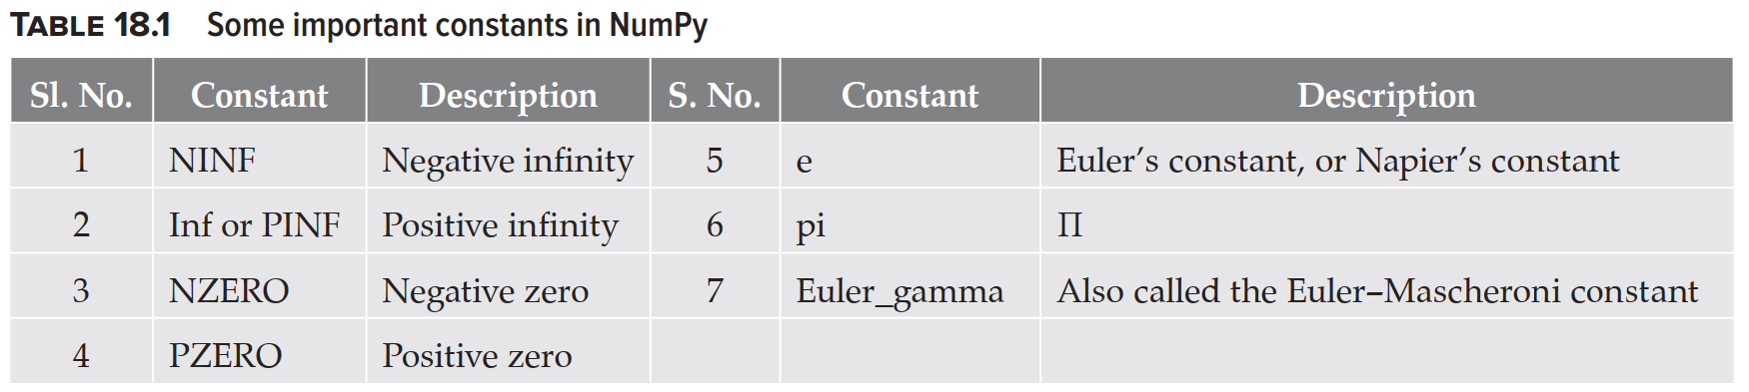
Numpy constants (Infinity, negative infinity, zero, negative zero and some other constants in NumPy)
[Examples showing use of these Numpy constants are shown on next slide]
Python Programming: Problem Solving, Packages and Libraries

Slide 82
Numpy constants – Example script
1 2 3 4 5 6 7 8 9 10 | import numpy as np print('Negative infinity->', np.NINF) print('Positive infinity->', np.PINF) print('Negative Zero->', np.NZERO) print('Positive Zero->', np.PZERO) print('Eulers constant->', np.e) print('Pi->', np.pi) print('euler_gamma->', np.euler_gamma) print('log 0 is infinity->', np.log(0) ) print('log -1 is nan->', np.log(-1) )
11 12 13 14 15 16 17 18 19 20 | # OUTPUT Negative infinity-> -inf Positive infinity-> inf Negative Zero-> -0.0 Positive Zero-> 0.0 Eulers constant-> 2.718281828459045 Pi-> 3.141592653589793 euler_gamma-> 0.5772156649015329 log 0 is infinity-> -inf log -1 is nan-> nan
Python Programming: Problem Solving, Packages and Libraries

Slide 83
np.linspace
NumPy has a method linspace. This method is very useful in getting evenly spaced numbers over an interval. Meaning of evenly spaced numbers:
Suppose you have an interval say [2, 4].
Suppose you want to divide this interval into 6 intervals then your list would be: [2. 2.4 2.8 3.2 3.6 4. ]. So this is the case where you divided an interval with start = 2, stop = 4 and interval = 6. Note here you also included the endpoint to the right, i.e., 4; so you did endpoint = True.
Now normally in many Python functions such as range(), the end point to the right is excluded. (For example, range(10) produces numbers from 0 to 9.) You could do this with the linspace method also by having endpoint = False.
The signature of linspace method is:
1 | numpy.linspace(start, stop, interval, endpoint=True)
Python Programming: Problem Solving, Packages and Libraries

Slide 84
np.linspace -- Example
1 2 3 4 5 6 | import numpy as np x1 = np.linspace(2, 4, 6, endpoint = True) print(x1) x2 = np.linspace(2, 4, 5, endpoint = False) # Have to reduce endpoint by 1 to get similar intervals print(x2)
7 8 9 | # OUTPUT [2. 2.4 2.8 3.2 3.6 4. ] [2. 2.4 2.8 3.2 3.6]
Line 4: Here the endpoint is False. Also note that the value of stop parameter has been reduced from 6 to 5.
Use of linspace() method: linspace() method is very useful in plotting of functions. Suppose you want to plot a function say sin(x) between x = 0° to x = 360°. You could divide the interval [0°, 360°] into say 10 intervals and then get values for sin(x) for each of these values of x and plot them.
Python Programming: Problem Solving, Packages and Libraries

Slide 85
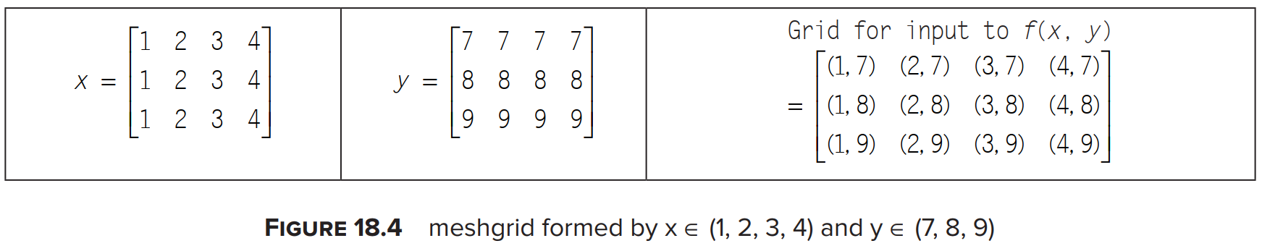
Understanding np.meshgrid()
To be able to do 3D plotting in Matplotlib, you first need to understand the concept of np.meshgrid() method.
To plot a function in 3D say x, y and z, you could have z = f(x,y) where f(x,y) is some function of x and y.
Now both x and y will have some domain and z will have a corresponding range.
Suppose the domain of x was integers from 1 to 4. So x ϵ (1, 2, 3, 4). Further, let y ϵ (7, 8, 9). So some of the possible inputs to f(x,y) could be f(1, 7), f(1, 8) and so on.
Suppose you wanted all possible combinations of x and y in form of a grid. Suppose you represent x, y and (x,y) as shown in Figure 18.4.
Python Programming: Problem Solving, Packages and Libraries

Slide 86
np.meshgrid() Example
1 2 3 4 5 6 7 | import numpy as np X = np.linspace(1, 4, 4) #X-> [1. 2. 3. 4.] Y = np.linspace(7, 9, 3) #Y-> [7. 8. 9.] Xgrid, Ygrid = np.meshgrid(X, Y) print('X->', X,'Y->', Y) print('Xgrid->', Xgrid) print('Ygrid->', Ygrid)
8 9 10 11 12 13 14 15 | #Output. . . X-> [1. 2. 3. 4.] Y-> [7. 8. 9.] Xgrid-> [[1. 2. 3. 4.] [1. 2. 3. 4.] [1. 2. 3. 4.]] Ygrid-> [[7. 7. 7. 7.] [8. 8. 8. 8.] [9. 9. 9. 9.]]
Python Programming: Problem Solving, Packages and Libraries

Slide 87
Using NumPy, SciPy for getting some basic information about a matrix
The SciPy library has a package called linalg for linear algebra.
NumPy also has a linalg package, but it is preferable to use SciPy.
NumPy and SciPy have a number of built-in functions to get some basic characteristics of a matrix.
For example, you can get characteristics like trace, rank, conjugate, norm, transpose and conjugate transpose.
Table 18.2 (On next slide) shows these operations.
Python Programming: Problem Solving, Packages and Libraries

Slide 88
Table 18.2: Some important methods of the linalg package of NumPy
 | Functions/ Methods | Purpose
1 | np.trace(A) | Gives trace of A., i.e., sum of all its diagonal elements
2 | linalg.inv(A) | Gives inverse. The inverse of a matrix has the property that if it is multiplied by the original matrix, you get an identity matrix
3 | A.T | Transpose of matrix
4 | A.H | Conjugate transpose
5 | linalg.det(A) | Determinant of a matrix
6 | linalg.matrix_norm(A) | Gives Frobenius norm (Default)
7 | linalg.norm(A, 1) | Gives L₁ norm
8 | np.linalg.matrix_rank(A) | Rank of matrix. Note function matrix_rank() is available in linalg module of NumPy and not in the linalg module of SciPy
Python Programming: Problem Solving, Packages and Libraries

Slide 89
Examples of some important methods of the linalg package of NumPy
1 2 3 4 5 6 7 8 9 10 11 12 13 14 15 16 17 18 19 20 | from scipy import linalg import numpy as np np.set_printoptions(precision=2, suppress = True) A = array([[0, -3, -2], [1, -4, -2], [-3, 4, 1]]) B = A.T print('Transpose of A->', B) C = linalg.inv(A) print('Inverse of A->', C) D = linalg.det(A) print('Determinant of A->', D) E = linalg.norm(A) print('Frobenius norm of A->', E) F = linalg.norm(A) print('L1 norm of A->', F) # Note that linalg is available both in numpy and scipy # Method matrix_rank() is available only in numpy G = np.linalg.matrix_rank(A) print('Rank of A->', G)
21 22 23 24 25 26 27 28 29 30 31 | # Output Transpose of A-> [[ 0 1 -3] [-3 -4 4] [-2 -2 1]] Inverse of A-> [[ 4. -5. -2.] [ 5. -6. -2.] [-8. 9. 3.]] Determinant of A-> 0.9999999999999991 Frobenius norm of A-> 7.745966692414834 L1 norm of A-> 7.745966692414834 Rank of A-> 3
Python Programming: Problem Solving, Packages and Libraries

Slide 90
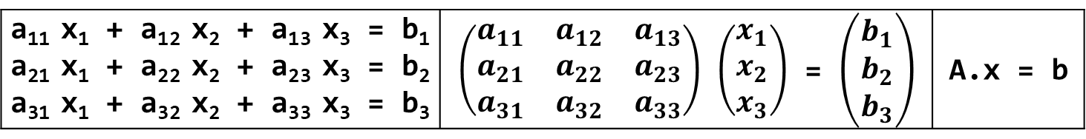
Solving linear system of equations
A general system of linear equations can be represented in the form of three matrices.
These matrices can be called (1) coefficient matrix (represented here as A) (2) variable matrix (represented here as vector x) and (3) constant matrix (represented here as b).
This is shown in Figure below.
a₁₁ x₁ + a₁₂ x₂ + a₁₃ x₃ = b₁ a₂₁ x₁ + a₂₂ x₂ + a₂₃ x₃ = b₂ a₃₁ x₁ + a₃₂ x₂ + a₃₃ x₃ = b₃ | $\left(\begin{matrix}a_{11} & a_{12} & a_{13} \\ a_{21} & a_{22} & a_{23} \\ a_{31} & a_{32} & a_{33}\end{matrix}\right)$ $\left(\begin{matrix}x_{1} \\ x_{2} \\ x_{3}\end{matrix}\right)$ = $\left(\begin{matrix}b_{1} \\ b_{2} \\ b_{3}\end{matrix}\right)$ | A.x = b
Python Programming: Problem Solving, Packages and Libraries

Slide 91
Example:- Solving linear system of equations
You can solve the following system of linear equations using the linalg module of NumPy. (1) 2x + 3y + z = 13, (2) x – y + 2z = 7 and (3) 3x + 4y + z = 22
1 2 3 4 5 6 7 8 9 10 11 12 13 14 15 16 17 | from scipy import linalg import numpy as np np.set_printoptions(precision=2, suppress = True) #2x + 3y + z = 13, x – y + 2z = 7, 3x + 4y + z = 22 A = np.array([[2, 3, 1], [1, -1, 2], [3, 4, 1]]) b = np.array([13, 7, 22]) # Use np.linalg.solve(A, b) # Return is an array of same shape as b # Here b is a 1-D array so return will be a 1-D array x = np.linalg.solve(A, b) print('x->', x) # Check solution ie A.x B = np.dot(A, x) print('b->', B) print('Is A.x == b?', np.allclose(B, b))
18 19 20 21 | # Output x-> [11. -2. -3.] b-> [13. 7. 22.] Is A.x == b? True
Python Programming: Problem Solving, Packages and Libraries

Slide 92
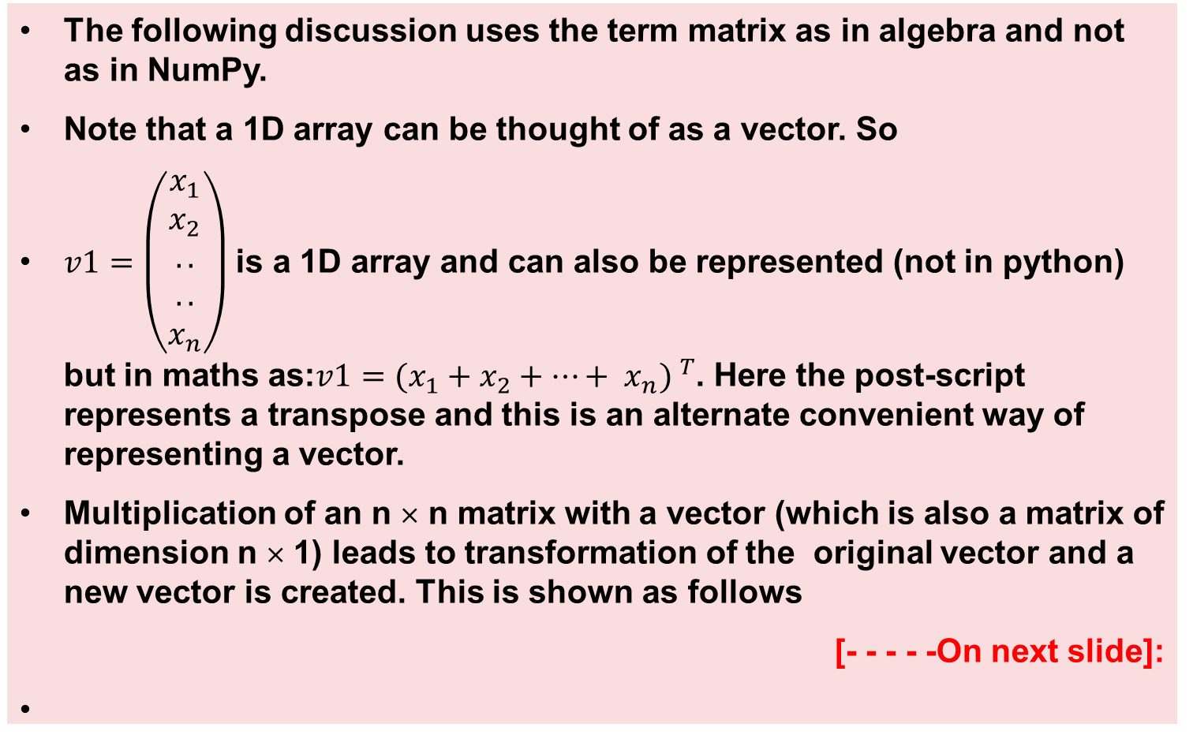
Multiplying a matrix by a vector –1
The following discussion uses the term matrix as in algebra and not as in NumPy.
Note that a 1D array can be thought of as a vector. So
$v1=\left(\begin{aligned}x_{1} \\ x_{2} \\ .. \\ .. \\ x_{n}\end{aligned}\right)$ is a 1D array and can also be represented (not in python) but in maths as:${{v1=(x}_{1}+x_{2}+…+ x_{n}) }^{T}$. Here the post-script represents a transpose and this is an alternate convenient way of representing a vector.
Multiplication of an n × n matrix with a vector (which is also a matrix of dimension n × 1) leads to transformation of the original vector and a new vector is created. This is shown as follows
[- - - - -On next slide]:
Python Programming: Problem Solving, Packages and Libraries

Slide 93
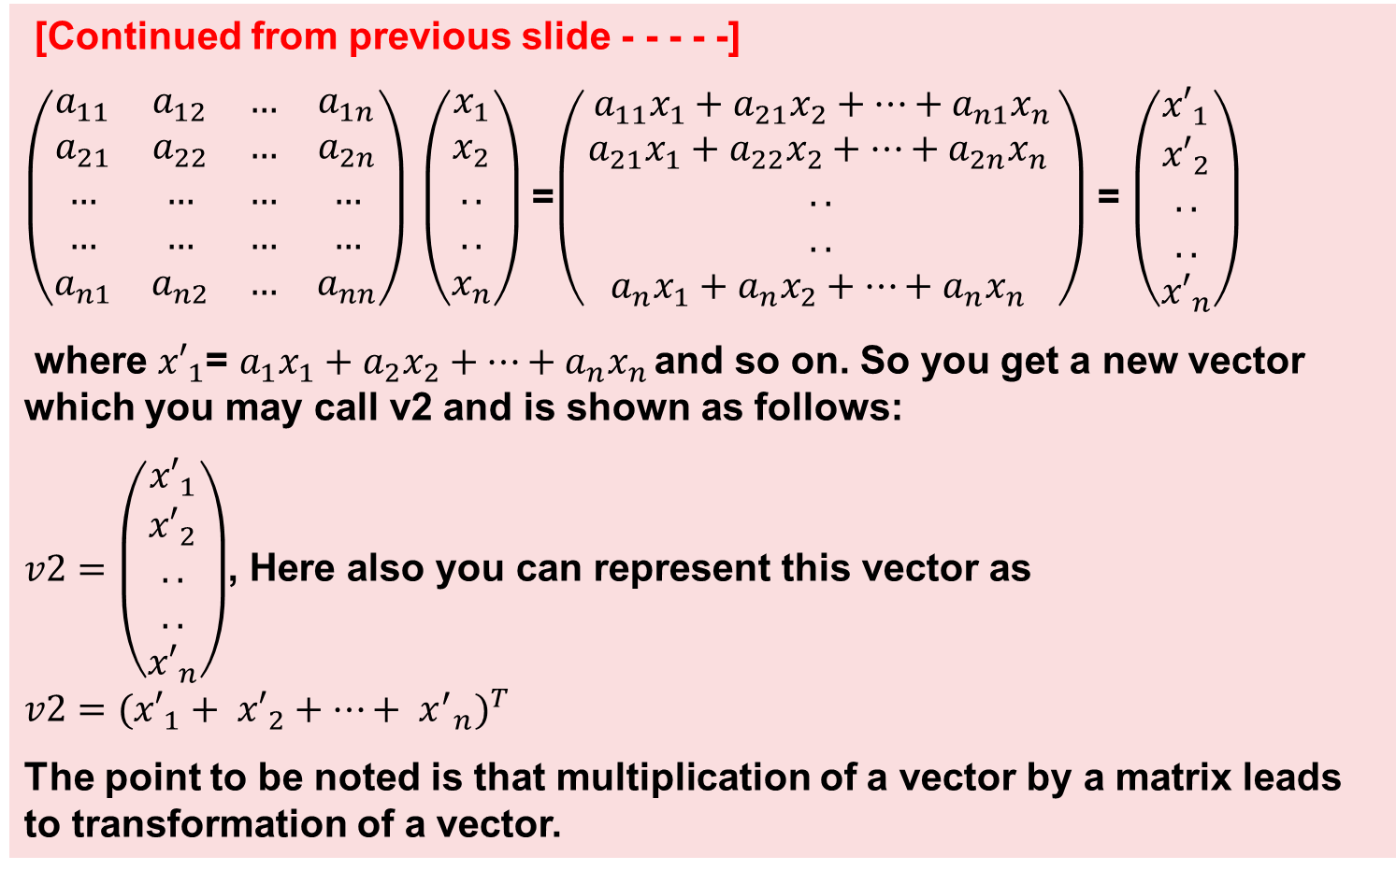
Multiplying a matrix by a vector –2
[Continued from previous slide - - - - -]
$\left(\begin{matrix}a_{11} & a_{12} & … & a_{1n} \\ a_{21} & a_{22} & … & a_{2n} \\ … & … & … & … \\ … & … & … & … \\ a_{n1} & a_{n2} & … & a_{nn}\end{matrix}\right) \left(\begin{aligned}x_{1} \\ x_{2} \\ .. \\ .. \\ x_{n}\end{aligned}\right)$ =$\left(\begin{aligned} {a_{11}x}_{1}+{a_{21}x}_{2}+…+{a_{n1}x}_{n } \\ {a_{21}x}_{1}+{a_{22}x}_{2}+…+{a_{2n}x}_{n } \\ .. \\ .. \\ {a_{n}x}_{1}+{a_{n}x}_{2}+…+{a_{n}x}_{n }\end{aligned}\right)$ = $\left(\begin{aligned}{x′}_{1} \\ {x′}_{2} \\ .. \\ .. \\ {x′}_{n}\end{aligned}\right)$
where ${x′}_{1}$= ${a_{1}x}_{1}+{a_{2}x}_{2}+…+{a_{n}x}_{n }$and so on. So you get a new vector which you may call v2 and is shown as follows:
$v2=\left(\begin{aligned}{x′}_{1} \\ {x′}_{2} \\ .. \\ .. \\ {x′}_{n}\end{aligned}\right)$, Here also you can represent this vector as ${{v2=(x′}_{1}+ {x′}_{2}+…+ {x^{′}}_{n})}^{T}$
The point to be noted is that multiplication of a vector by a matrix leads to transformation of a vector.
Python Programming: Problem Solving, Packages and Libraries

Slide 94
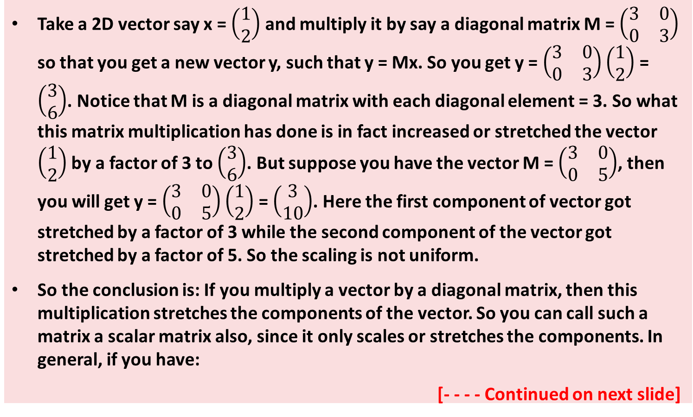
Multiplication of a diagonal matrix to a vector (Scaling) -- 1
Take a 2D vector say x = $\left(\begin{aligned}1 \\ 2\end{aligned}\right)$ and multiply it by say a diagonal matrix M = $\left(\begin{matrix}3 & 0 \\ 0 & 3\end{matrix}\right)$ so that you get a new vector y, such that y = Mx. So you get y = $\left(\begin{matrix}3 & 0 \\ 0 & 3\end{matrix}\right)\left(\begin{aligned}1 \\ 2\end{aligned}\right)$ = $\left(\begin{aligned}3 \\ 6\end{aligned}\right)$. Notice that M is a diagonal matrix with each diagonal element = 3. So what this matrix multiplication has done is in fact increased or stretched the vector $\left(\begin{aligned}1 \\ 2\end{aligned}\right)$ by a factor of 3 to $\left(\begin{aligned}3 \\ 6\end{aligned}\right)$. But suppose you have the vector M = $\left(\begin{matrix}3 & 0 \\ 0 & 5\end{matrix}\right)$, then you will get y = $\left(\begin{matrix}3 & 0 \\ 0 & 5\end{matrix}\right)\left(\begin{aligned}1 \\ 2\end{aligned}\right)$ = $\left(\begin{aligned}3 \\ 10\end{aligned}\right)$. Here the first component of vector got stretched by a factor of 3 while the second component of the vector got stretched by a factor of 5. So the scaling is not uniform.
So the conclusion is: If you multiply a vector by a diagonal matrix, then this multiplication stretches the components of the vector. So you can call such a matrix a scalar matrix also, since it only scales or stretches the components. In general, if you have:
[- - - - Continued on next slide]
Python Programming: Problem Solving, Packages and Libraries

Slide 95
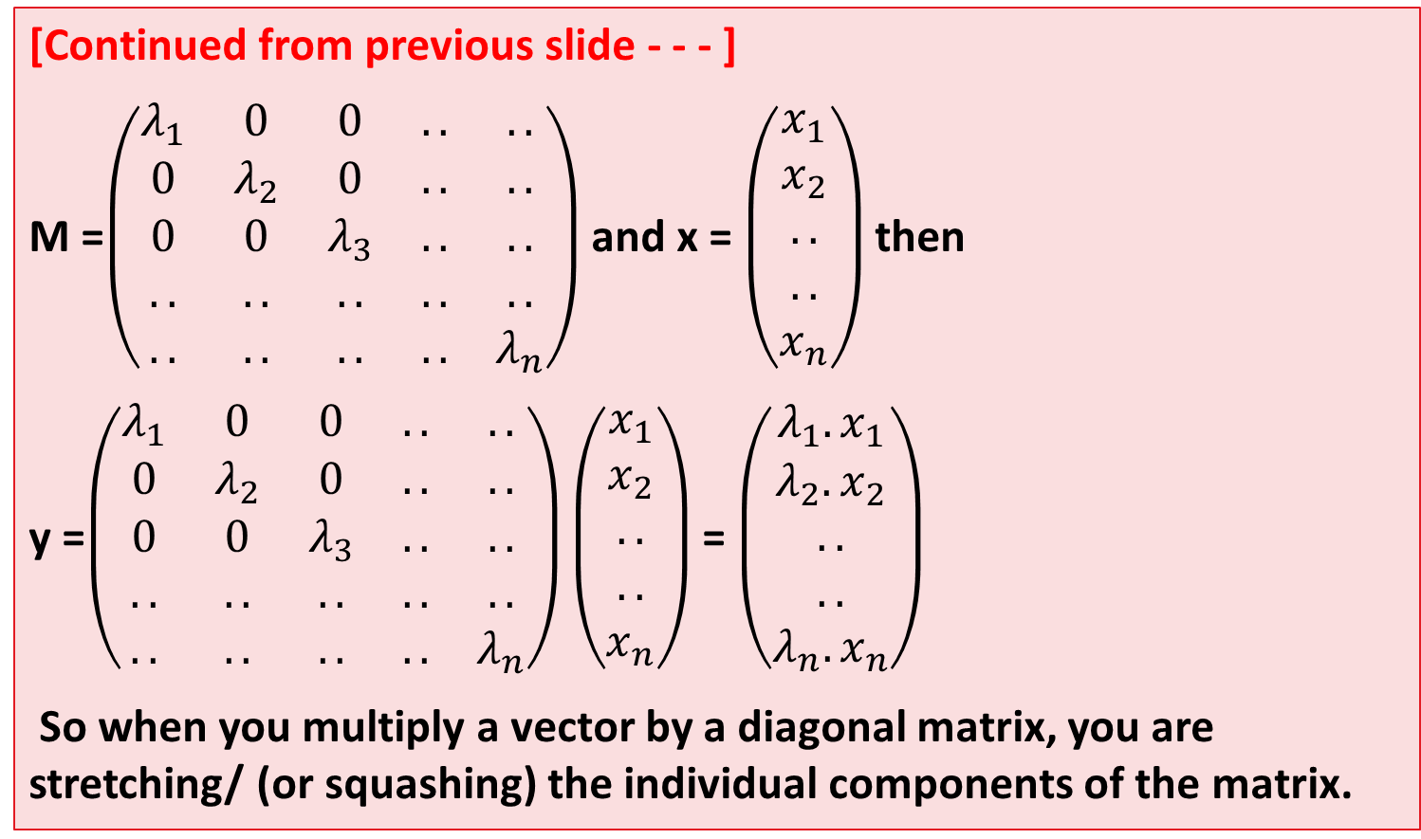
Multiplication of a diagonal matrix to a vector (Scaling) -- 2
[Continued from previous slide - - - ]
M =$\left(\begin{matrix}λ_{1} & 0 & 0 & .. & .. \\ 0 & λ_{2} & 0 & .. & .. \\ 0 & 0 & λ_{3} & .. & .. \\ .. & .. & .. & .. & .. \\ .. & .. & .. & .. & λ_{n}\end{matrix}\right)$ and x = $\left(\begin{aligned}x_{1} \\ x_{2} \\ .. \\ .. \\ x_{n}\end{aligned}\right)$ then
y =$\left(\begin{matrix}λ_{1} & 0 & 0 & .. & .. \\ 0 & λ_{2} & 0 & .. & .. \\ 0 & 0 & λ_{3} & .. & .. \\ .. & .. & .. & .. & .. \\ .. & .. & .. & .. & λ_{n}\end{matrix}\right)\left(\begin{aligned}x_{1} \\ x_{2} \\ .. \\ .. \\ x_{n}\end{aligned}\right)$ = $\left(\begin{aligned}{λ_{1}.x}_{1} \\ {λ_{2}.x}_{2} \\ .. \\ .. \\ {λ_{n}.x}_{n}\end{aligned}\right)$
So when you multiply a vector by a diagonal matrix, you are stretching/ (or squashing) the individual components of the matrix.
Python Programming: Problem Solving, Packages and Libraries

Slide 96
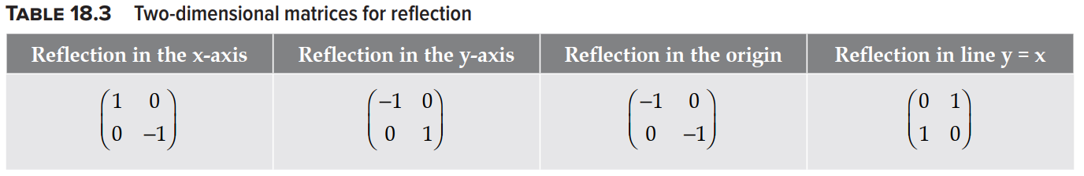
Matrix multiplication as a reflection
Consider a 2D system and a point say (1, 2).
Then the reflection of this point on the x-axis will be (1, -2) and its reflection on y-axis will be(-1, 2).
Also its reflection about the origin will be (-1, -2)
Table 18.3 shows the matrices for various reflections in 2D.
Python Programming: Problem Solving, Packages and Libraries

Slide 97
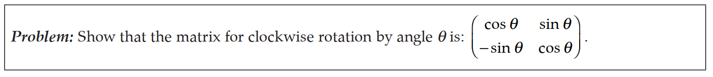
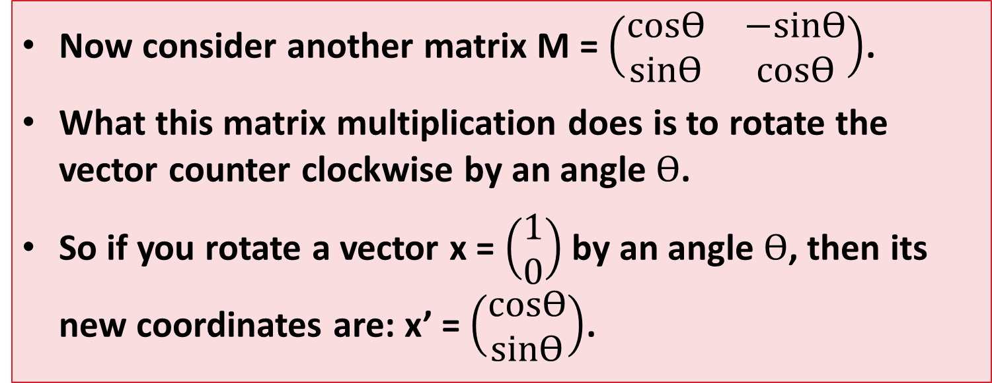
Matrix multiplication as rotation
Now consider another matrix M = $\left(\begin{matrix}cosƟ & −sinƟ \\ sinƟ & cosƟ\end{matrix}\right)$.
What this matrix multiplication does is to rotate the vector counter clockwise by an angle $Ɵ$.
So if you rotate a vector x = $\left(\begin{aligned}1 \\ 0\end{aligned}\right)$ by an angle $Ɵ$, then its new coordinates are: x’ = $\left(\begin{matrix}cosƟ \\ sinƟ\end{matrix}\right)$.
Python Programming: Problem Solving, Packages and Libraries

Slide 98
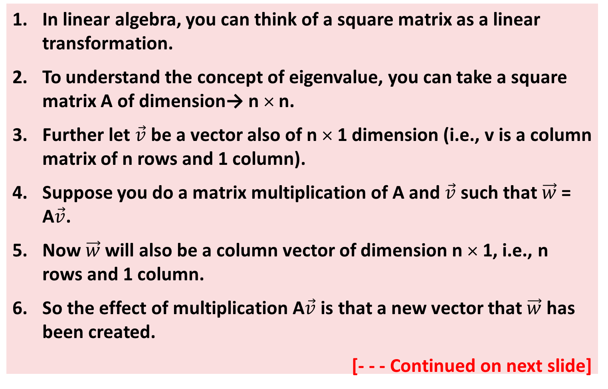
Eigenvalues and eigenvectors -- 1
In linear algebra, you can think of a square matrix as a linear transformation.
To understand the concept of eigenvalue, you can take a square matrix A of dimension→ n × n.
Further let $\vec{v}$ be a vector also of n × 1 dimension (i.e., v is a column matrix of n rows and 1 column).
Suppose you do a matrix multiplication of A and $\vec{v}$ such that $\vec{w}$ = A$\vec{v}$.
Now $\vec{w}$will also be a column vector of dimension n × 1, i.e., n rows and 1 column.
So the effect of multiplication A$\vec{v}$ is that a new vector that $\vec{w}$ has been created.
[- - - Continued on next slide]
Python Programming: Problem Solving, Packages and Libraries

Slide 99
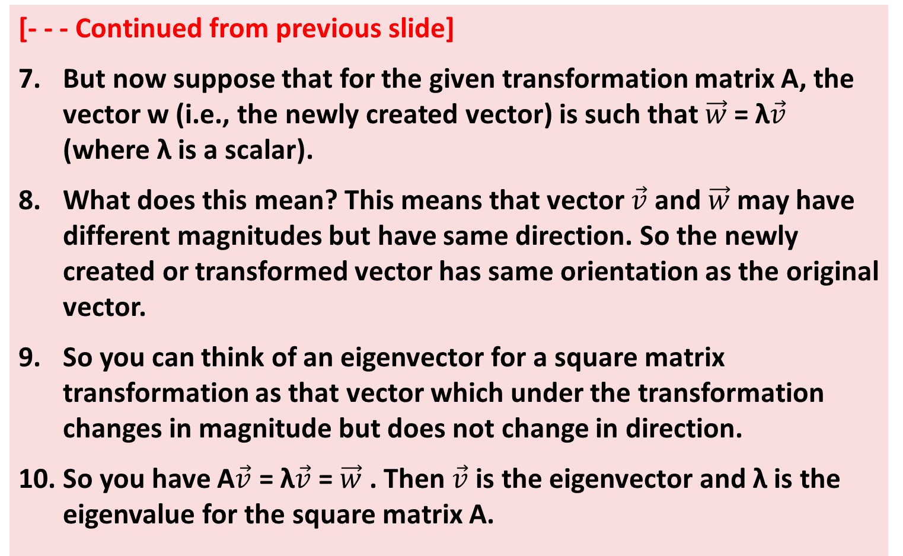
Eigenvalues and eigenvectors -- 2
[- - - Continued from previous slide]
But now suppose that for the given transformation matrix A, the vector w (i.e., the newly created vector) is such that $\vec{w}$ = λ$\vec{v}$ (where λ is a scalar).
What does this mean? This means that vector $\vec{v}$ and $\vec{w}$ may have different magnitudes but have same direction. So the newly created or transformed vector has same orientation as the original vector.
So you can think of an eigenvector for a square matrix transformation as that vector which under the transformation changes in magnitude but does not change in direction.
So you have A$\vec{v}$ = λ$\vec{v}$ = $\vec{w}$ . Then $\vec{v}$ is the eigenvector and λ is the eigenvalue for the square matrix A.
Python Programming: Problem Solving, Packages and Libraries

Slide 100
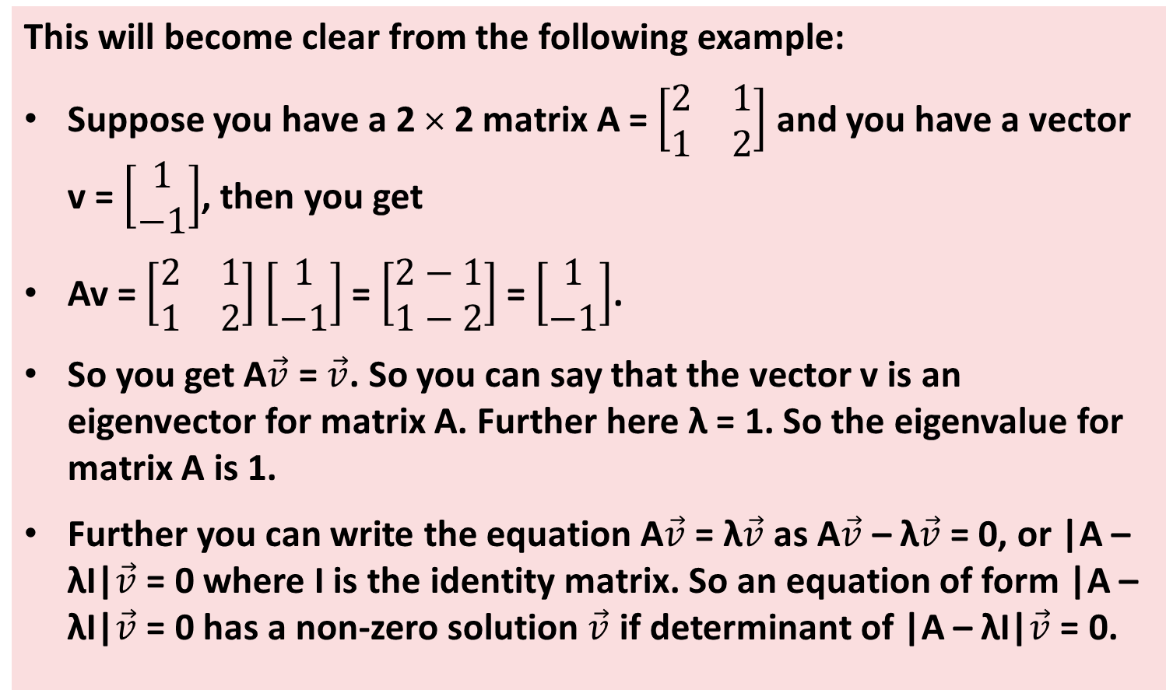
Eigenvalues and eigenvectors -- 3
This will become clear from the following example:
Suppose you have a 2 × 2 matrix A = $\left[\begin{matrix}2 & 1 \\ 1 & 2\end{matrix}\right]$ and you have a vector v = $\left[\begin{aligned}1 \\ −1\end{aligned}\right]$, then you get
Av = $\left[\begin{matrix}2 & 1 \\ 1 & 2\end{matrix}\right]$ $\left[\begin{aligned}1 \\ −1\end{aligned}\right]$ = $\left[\begin{aligned}2−1 \\ 1−2\end{aligned}\right]$ = $\left[\begin{aligned}1 \\ −1\end{aligned}\right]$.
So you get A$\vec{v}$ = $\vec{v}$. So you can say that the vector v is an eigenvector for matrix A. Further here λ = 1. So the eigenvalue for matrix A is 1.
Further you can write the equation A$\vec{v}$ = λ$\vec{v}$ as A$\vec{v}$ – λ$\vec{v}$ = 0, or |A – λI|$\vec{v}$ = 0 where I is the identity matrix. So an equation of form |A – λI|$\vec{v}$ = 0 has a non-zero solution $\vec{v}$ if determinant of |A – λI|$\vec{v}$ = 0.
Python Programming: Problem Solving, Packages and Libraries

Slide 101
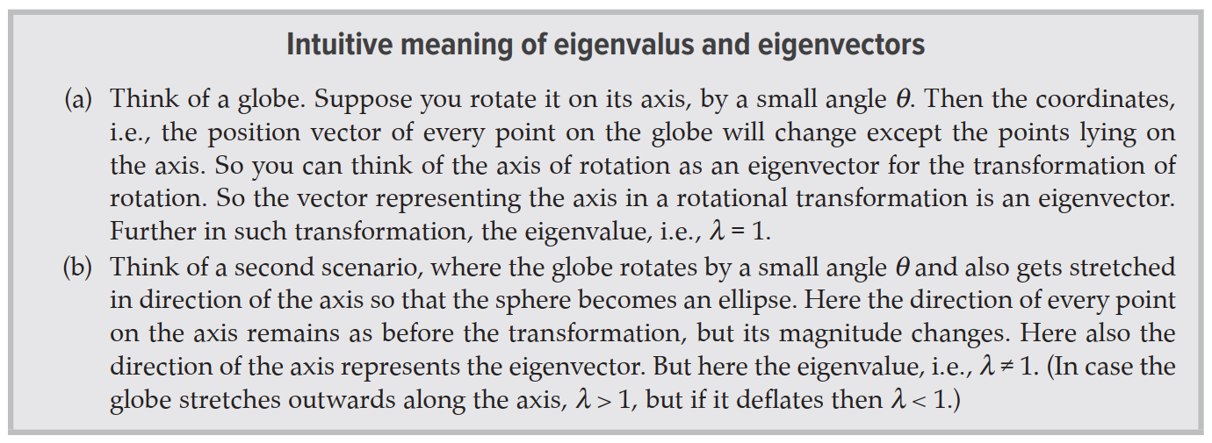
Eigenvalues and eigenvectors – 4 (Intuitive meaning of eigen values and eigen vectors)
Python Programming: Problem Solving, Packages and Libraries

Slide 102
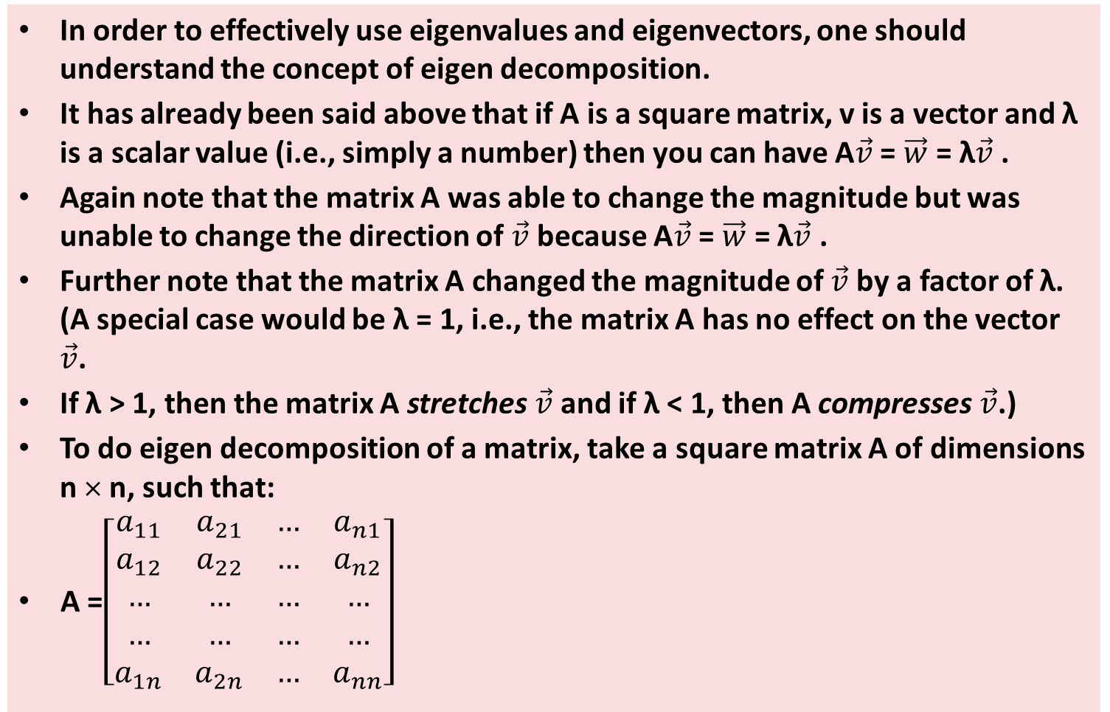
Eigen decomposition - - 1
In order to effectively use eigenvalues and eigenvectors, one should understand the concept of eigen decomposition.
It has already been said above that if A is a square matrix, v is a vector and λ is a scalar value (i.e., simply a number) then you can have A$\vec{v}$ = $\vec{w}$ = λ$\vec{v}$ .
Again note that the matrix A was able to change the magnitude but was unable to change the direction of $\vec{v}$ because A$\vec{v}$ = $\vec{w}$ = λ$\vec{v}$ .
Further note that the matrix A changed the magnitude of $\vec{v}$ by a factor of λ. (A special case would be λ = 1, i.e., the matrix A has no effect on the vector $\vec{v}$.
If λ > 1, then the matrix A stretches $\vec{v}$ and if λ < 1, then A compresses $\vec{v}$.)
To do eigen decomposition of a matrix, take a square matrix A of dimensions n × n, such that:
A =$\left[\begin{matrix}a_{11} & a_{21} & … & a_{n1} \\ a_{12} & a_{22} & … & a_{n2} \\ … & … & … & … \\ … & … & … & … \\ a_{1n} & a_{2n} & … & a_{nn}\end{matrix}\right]$
Python Programming: Problem Solving, Packages and Libraries

Slide 103
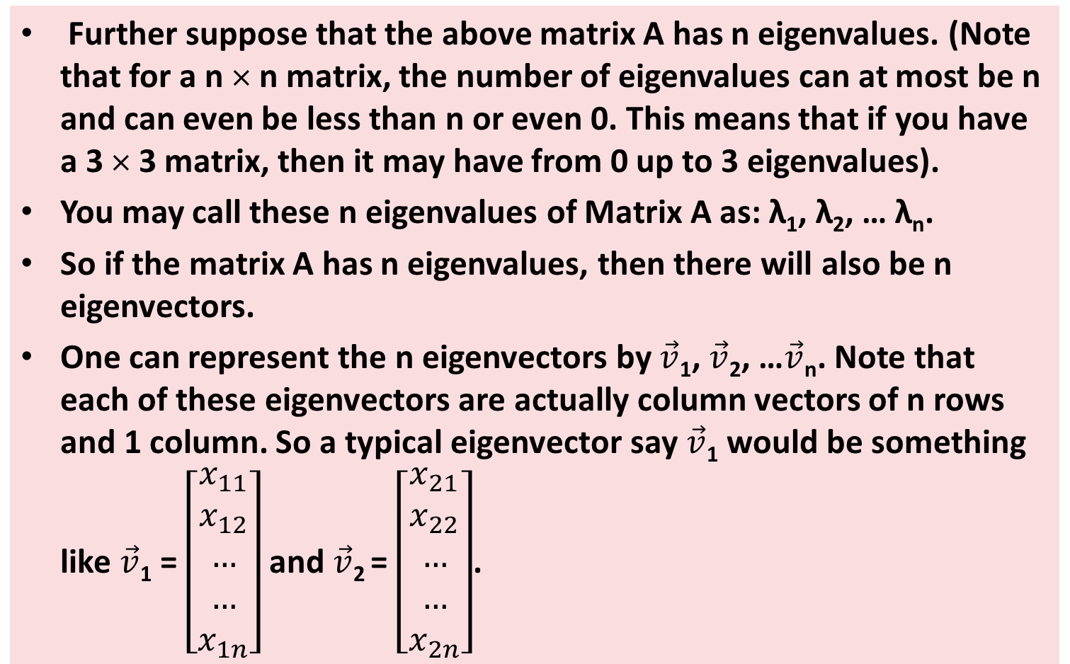
Eigen decomposition - - 2
Further suppose that the above matrix A has n eigenvalues. (Note that for a n × n matrix, the number of eigenvalues can at most be n and can even be less than n or even 0. This means that if you have a 3 × 3 matrix, then it may have from 0 up to 3 eigenvalues).
You may call these n eigenvalues of Matrix A as: λ₁, λ₂, … λ_{n}.
So if the matrix A has n eigenvalues, then there will also be n eigenvectors.
One can represent the n eigenvectors by $\vec{v}$₁, $\vec{v}$₂, …$\vec{v}$_{n}. Note that each of these eigenvectors are actually column vectors of n rows and 1 column. So a typical eigenvector say $\vec{v}$₁ would be something like $\vec{v}$₁ = $\left[\begin{matrix}x_{11} \\ x_{12} \\ … \\ … \\ x_{1n}\end{matrix}\right]$ and $\vec{v}$₂ = $\left[\begin{matrix}x_{21} \\ x_{22} \\ … \\ … \\ x_{2n}\end{matrix}\right]$.
Python Programming: Problem Solving, Packages and Libraries

Slide 104
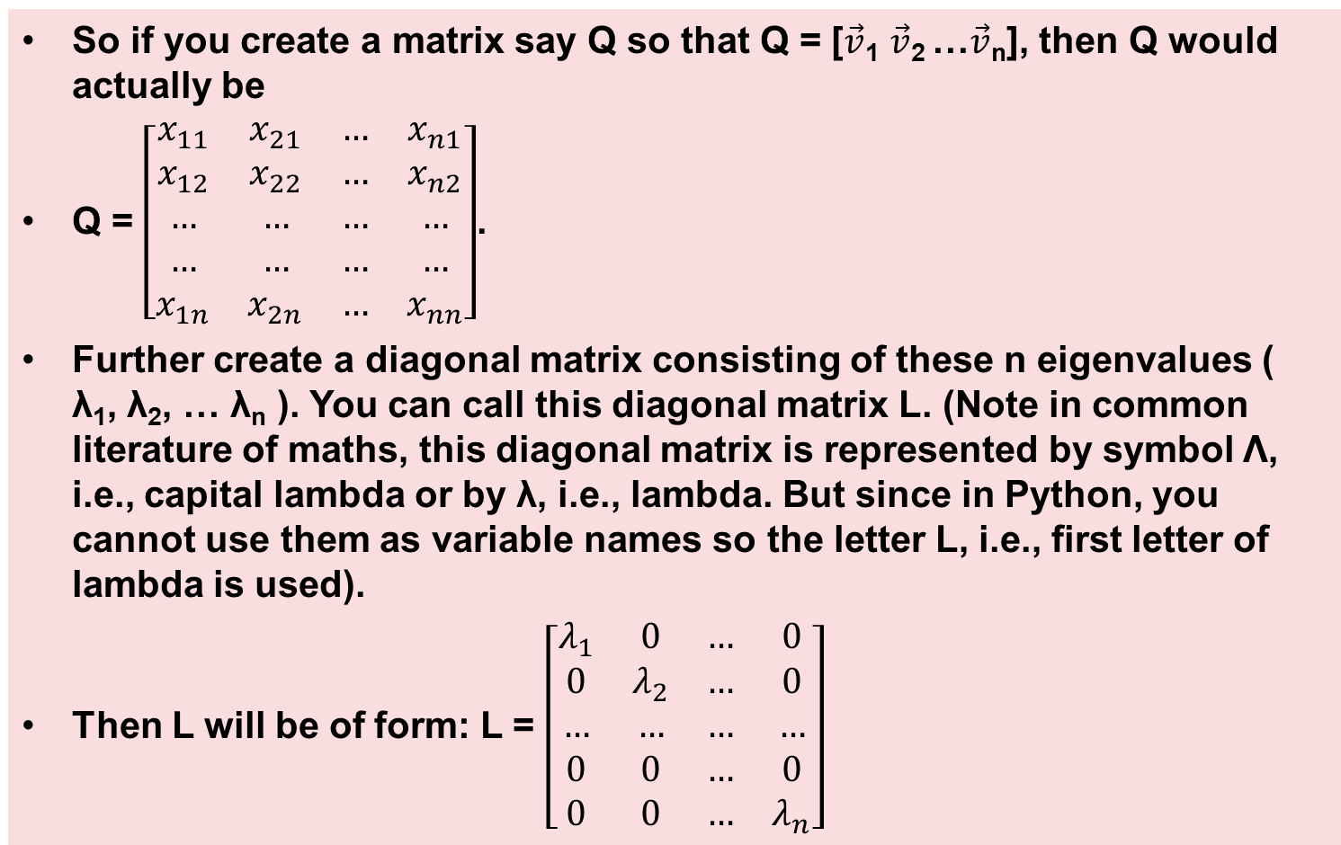
Eigen decomposition - - 3
So if you create a matrix say Q so that Q = [$\vec{v}$₁ $\vec{v}$₂ …$\vec{v}$_{n}], then Q would actually be
Q = $\left[\begin{matrix}x_{11} & x_{21} & … & x_{n1} \\ x_{12} & x_{22} & … & x_{n2} \\ … & … & … & … \\ … & … & … & … \\ x_{1n} & x_{2n} & … & x_{nn}\end{matrix}\right]$.
Further create a diagonal matrix consisting of these n eigenvalues ( λ₁, λ₂, … λ_{n} ). You can call this diagonal matrix L. (Note in common literature of maths, this diagonal matrix is represented by symbol Λ, i.e., capital lambda or by λ, i.e., lambda. But since in Python, you cannot use them as variable names so the letter L, i.e., first letter of lambda is used).
Then L will be of form: L = $\left[\begin{matrix}λ_{1} & 0 & … & 0 \\ 0 & λ_{2} & … & 0 \\ … & … & … & … \\ 0 & 0 & … & 0 \\ 0 & 0 & … & λ_{n}\end{matrix}\right]$
Python Programming: Problem Solving, Packages and Libraries

Slide 105
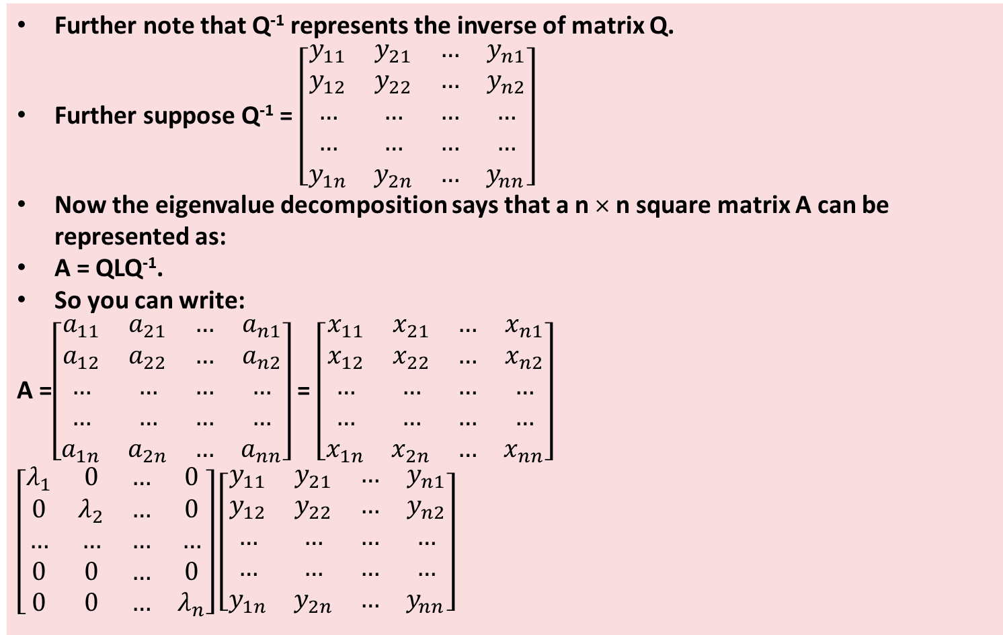
Eigen decomposition - - 4
Further note that Q⁻¹ represents the inverse of matrix Q.
Further suppose Q⁻¹ = $\left[\begin{matrix}y_{11} & y_{21} & … & y_{n1} \\ y_{12} & y_{22} & … & y_{n2} \\ … & … & … & … \\ … & … & … & … \\ y_{1n} & y_{2n} & … & y_{nn}\end{matrix}\right]$
Now the eigenvalue decomposition says that a n × n square matrix A can be represented as:
A = QLQ⁻¹.
So you can write:
A =$\left[\begin{matrix}a_{11} & a_{21} & … & a_{n1} \\ a_{12} & a_{22} & … & a_{n2} \\ … & … & … & … \\ … & … & … & … \\ a_{1n} & a_{2n} & … & a_{nn}\end{matrix}\right]$ = $\left[\begin{matrix}x_{11} & x_{21} & … & x_{n1} \\ x_{12} & x_{22} & … & x_{n2} \\ … & … & … & … \\ … & … & … & … \\ x_{1n} & x_{2n} & … & x_{nn}\end{matrix}\right]$ $\left[\begin{matrix}λ_{1} & 0 & … & 0 \\ 0 & λ_{2} & … & 0 \\ … & … & … & … \\ 0 & 0 & … & 0 \\ 0 & 0 & … & λ_{n}\end{matrix}\right]\left[\begin{matrix}y_{11} & y_{21} & … & y_{n1} \\ y_{12} & y_{22} & … & y_{n2} \\ … & … & … & … \\ … & … & … & … \\ y_{1n} & y_{2n} & … & y_{nn}\end{matrix}\right]$
Python Programming: Problem Solving, Packages and Libraries

Slide 106
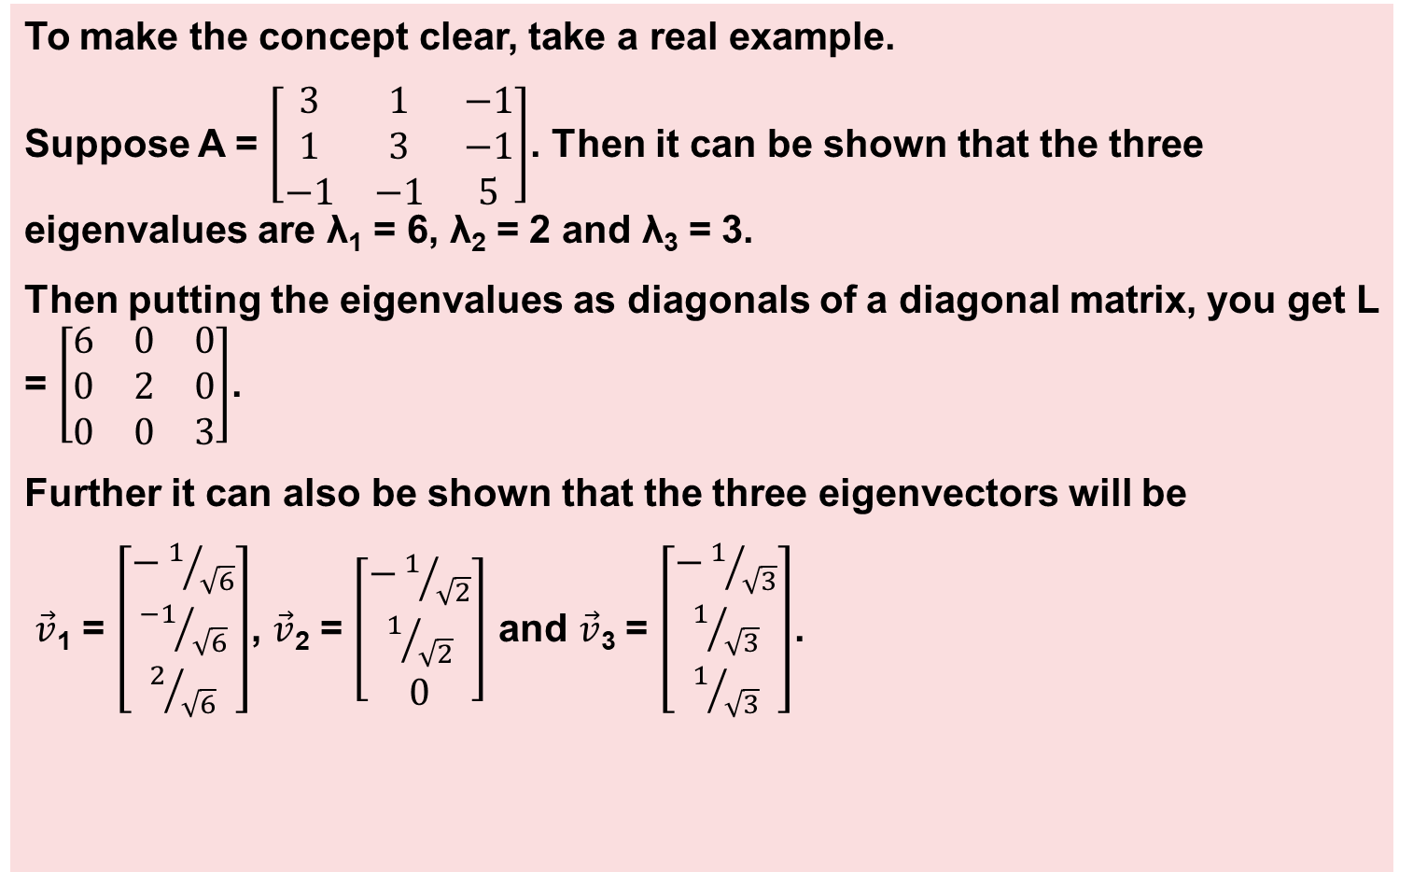
Eigen decomposition example - - 1
To make the concept clear, take a real example.
Suppose A = $\left[\begin{matrix}3 & 1 & −1 \\ 1 & 3 & −1 \\ −1 & −1 & 5\end{matrix}\right]$. Then it can be shown that the three eigenvalues are λ₁ = 6, λ₂ = 2 and λ₃ = 3.
Then putting the eigenvalues as diagonals of a diagonal matrix, you get L = $\left[\begin{matrix}6 & 0 & 0 \\ 0 & 2 & 0 \\ 0 & 0 & 3\end{matrix}\right]$.
Further it can also be shown that the three eigenvectors will be
$\vec{v}$₁ = $\left[\begin{matrix}−1/{\sqrt{6}} \\ {−1}/{\sqrt{6}} \\ 2/{\sqrt{6}}\end{matrix}\right]$, $\vec{v}$₂ = $\left[\begin{matrix}−1/{\sqrt{2}} \\ 1/{\sqrt{2}} \\ 0\end{matrix}\right]$ and $\vec{v}$₃ = $\left[\begin{matrix}−1/{\sqrt{3}} \\ 1/{\sqrt{3}} \\ 1/{\sqrt{3}}\end{matrix}\right]$.
Python Programming: Problem Solving, Packages and Libraries

Slide 107
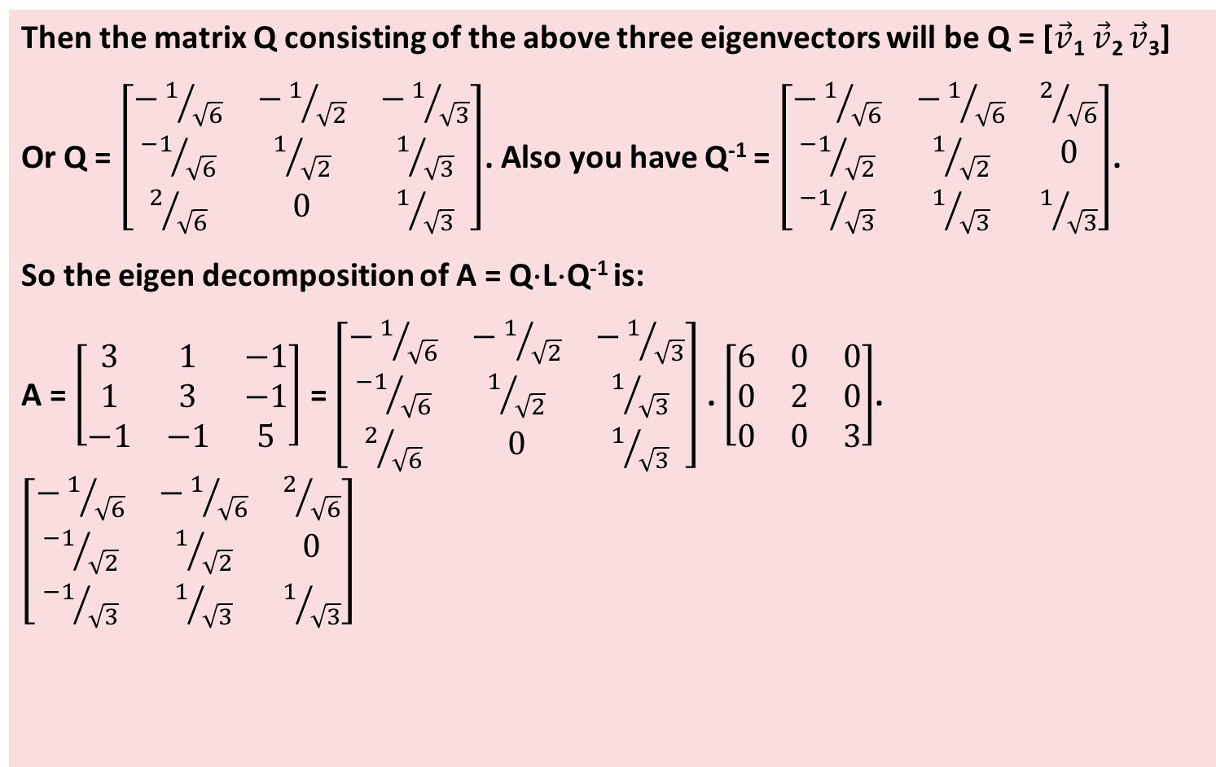
Eigen decomposition example - - 2
Then the matrix Q consisting of the above three eigenvectors will be Q = [$\vec{v}$₁ $\vec{v}$₂ $\vec{v}$₃]
Or Q = $\left[\begin{matrix}−1/{\sqrt{6}} & −1/{\sqrt{2}} & −1/{\sqrt{3}} \\ {−1}/{\sqrt{6}} & 1/{\sqrt{2}} & 1/{\sqrt{3}} \\ 2/{\sqrt{6}} & 0 & 1/{\sqrt{3}}\end{matrix}\right]$. Also you have Q⁻¹ = $\left[\begin{matrix}−1/{\sqrt{6}} & −1/{\sqrt{6}} & 2/{\sqrt{6}} \\ {−1}/{\sqrt{2}} & 1/{\sqrt{2}} & 0 \\ {−1}/{\sqrt{3}} & 1/{\sqrt{3}} & 1/{\sqrt{3}}\end{matrix}\right]$.
So the eigen decomposition of A = Q⋅L⋅Q⁻¹ is:
A = $\left[\begin{matrix}3 & 1 & −1 \\ 1 & 3 & −1 \\ −1 & −1 & 5\end{matrix}\right]$ = $\left[\begin{matrix}−1/{\sqrt{6}} & −1/{\sqrt{2}} & −1/{\sqrt{3}} \\ {−1}/{\sqrt{6}} & 1/{\sqrt{2}} & 1/{\sqrt{3}} \\ 2/{\sqrt{6}} & 0 & 1/{\sqrt{3}}\end{matrix}\right]$ . $\left[\begin{matrix}6 & 0 & 0 \\ 0 & 2 & 0 \\ 0 & 0 & 3\end{matrix}\right]$. $\left[\begin{matrix}−1/{\sqrt{6}} & −1/{\sqrt{6}} & 2/{\sqrt{6}} \\ {−1}/{\sqrt{2}} & 1/{\sqrt{2}} & 0 \\ {−1}/{\sqrt{3}} & 1/{\sqrt{3}} & 1/{\sqrt{3}}\end{matrix}\right]$
Python Programming: Problem Solving, Packages and Libraries

Slide 108
Eigen decomposition example - - 3
The following example from the book shows the use of eigen decomposition.
[The output is not given]
1 2 3 4 5 6 7 8 9 10 11 12 13 14 15 16 17 18 19 20 21 22 23 24 25 26 27 28 29 30 31 32 33 | import numpy as np from numpy import dot # Otherwise you have to use np.dot from numpy.linalg import eig, inv np.set_printoptions(precision=2, suppress = True) #1--------define a matrix A = np.array([[3, 1, -1], [1, 3, -1], [-1, -1, 5]]) print('A->') print(A)# Check A #2(a)---get eigen values as a 1-D array and eigen vectors as matrix Q eig_arr, Q = eig(A) print('Eigen values->', eig_arr)# eigen values are a 1-D array print('Eigen vectors as a matrix->') print(Q)# eigen vectors are columns of a square matrix #2(b)------ Convert 1-D eigenvalue array eig_arr into matrix L L = np.diag(eig_arr) print('Eigen values as a diagonal matrix->') print(L)# Confirm L is a diagonal matrix #3(a)----------Get inverse of the eigen vector matrix Q Q_inv = inv(Q) print('Inverse of eigen vector matrix->') print(Q_inv)# Confirm that inverse of eigen vector matrix is OK #3(b)----Intermediate result ie B = L.Q_inv B = L.dot(Q_inv) print('Intermediate result B->') print(B) # B is just an intermediate result #3(c)------ get C = (Q).((L).(Q_inv)) ie C = Q.B C = Q.dot(B) print('C = (Q).((L).(Q_inv))->') print(C) #4----------Check if A and C are same/ similar print('Is A similar to C?', np.allclose(A, C))
Python Programming: Problem Solving, Packages and Libraries

Slide 109
Singular Value Decomposition
SVD is a decomposition of a m × n matrix say A into three matrices U, Ʃ and V such that: A = UƩV^{T} ;
Where
U is an m × m unitary column orthogonal matrix. (Note for a unitary matrix U, UU^{T} = I). (Also note that column orthogonal means that any two columns of this matrix are orthogonal to each other meaning that the dot products of entries in any two columns will give a 0).
Ʃ is a m × n rectangular diagonal matrix with nonnegative numbers on its diagonal. (Rectangular diagonal matrix means all entries not on diagonal are 0).
V is a n × n unitary column orthogonal matrix.
Note:
The diagonal entries of Ʃ are referred to as the singular values of A.
The columns of U are referred to as the left-singular vectors of A.
The columns of V are referred to as the right-singular vectors of A.
Python Programming: Problem Solving, Packages and Libraries

Slide 110
SVD -- 1
You can clearly see that SVD is very similar to eigen decomposition. The important differences are:
Eigen decomposition is done for a square matrix, but SVD can be done for a non-square matrix also.
In eigen decomposition, when you form the diagonal matrix L from the eigenvalues, you don’t insist upon the eigenvalues to be in any particular order. But in SVD, by convention you put the eigenvalues in the diagonal matrix in descending order on the diagonal.
Python Programming: Problem Solving, Packages and Libraries

Slide 111
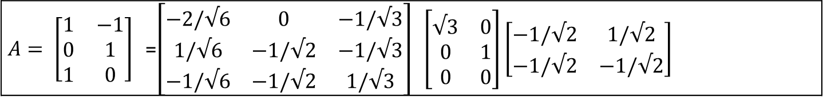
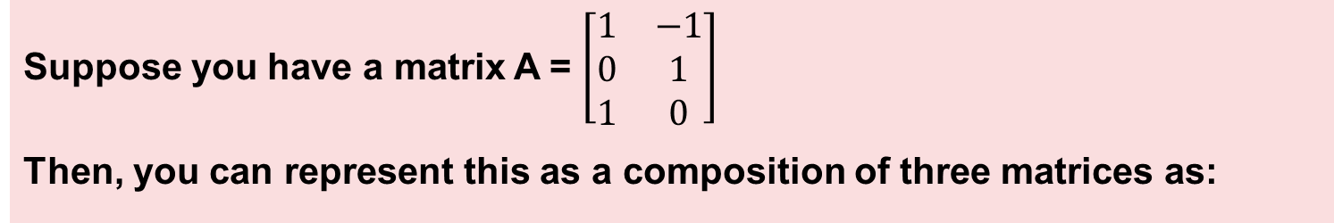
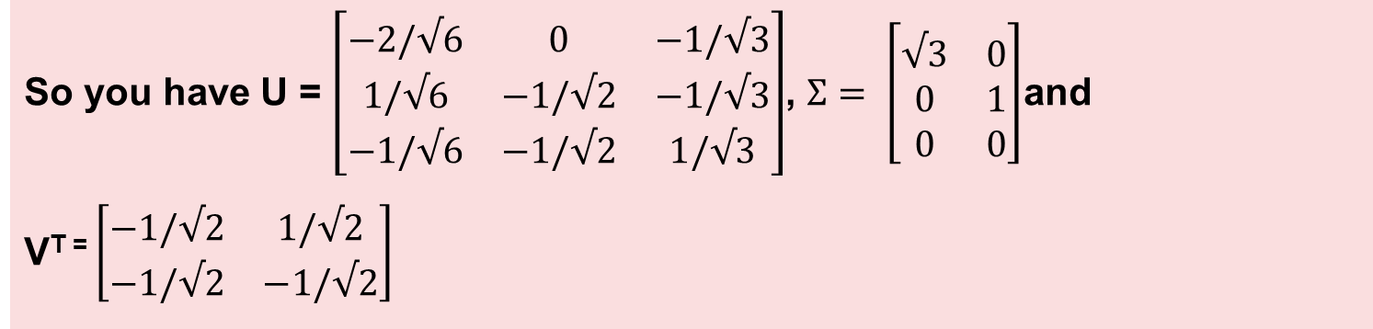
SVD -- 2
Suppose you have a matrix A = $\left[\begin{matrix}1 & −1 \\ 0 & 1 \\ 1 & 0\end{matrix}\right]$
Then, you can represent this as a composition of three matrices as:
$A= \left[\begin{matrix}1 & −1 \\ 0 & 1 \\ 1 & 0\end{matrix}\right]$ =$\left[\begin{matrix}−2/√6 & 0 & −1/√3 \\ 1/√6 & −1/√2 & −1/√3 \\ −1/√6 & −1/√2 & 1/√3\end{matrix}\right]$ $\left[\begin{matrix}√3 & 0 \\ 0 & 1 \\ 0 & 0\end{matrix}\right]\left[\begin{matrix}−1/√2 & 1/√2 \\ −1/√2 & −1/√2\end{matrix}\right]$
So you have U = $\left[\begin{matrix}−2/√6 & 0 & −1/√3 \\ 1/√6 & −1/√2 & −1/√3 \\ −1/√6 & −1/√2 & 1/√3\end{matrix}\right]$, $Ʃ= \left[\begin{matrix}√3 & 0 \\ 0 & 1 \\ 0 & 0\end{matrix}\right]$and
V^{T =} $\left[\begin{matrix}−1/√2 & 1/√2 \\ −1/√2 & −1/√2\end{matrix}\right]$
Python Programming: Problem Solving, Packages and Libraries

Slide 112
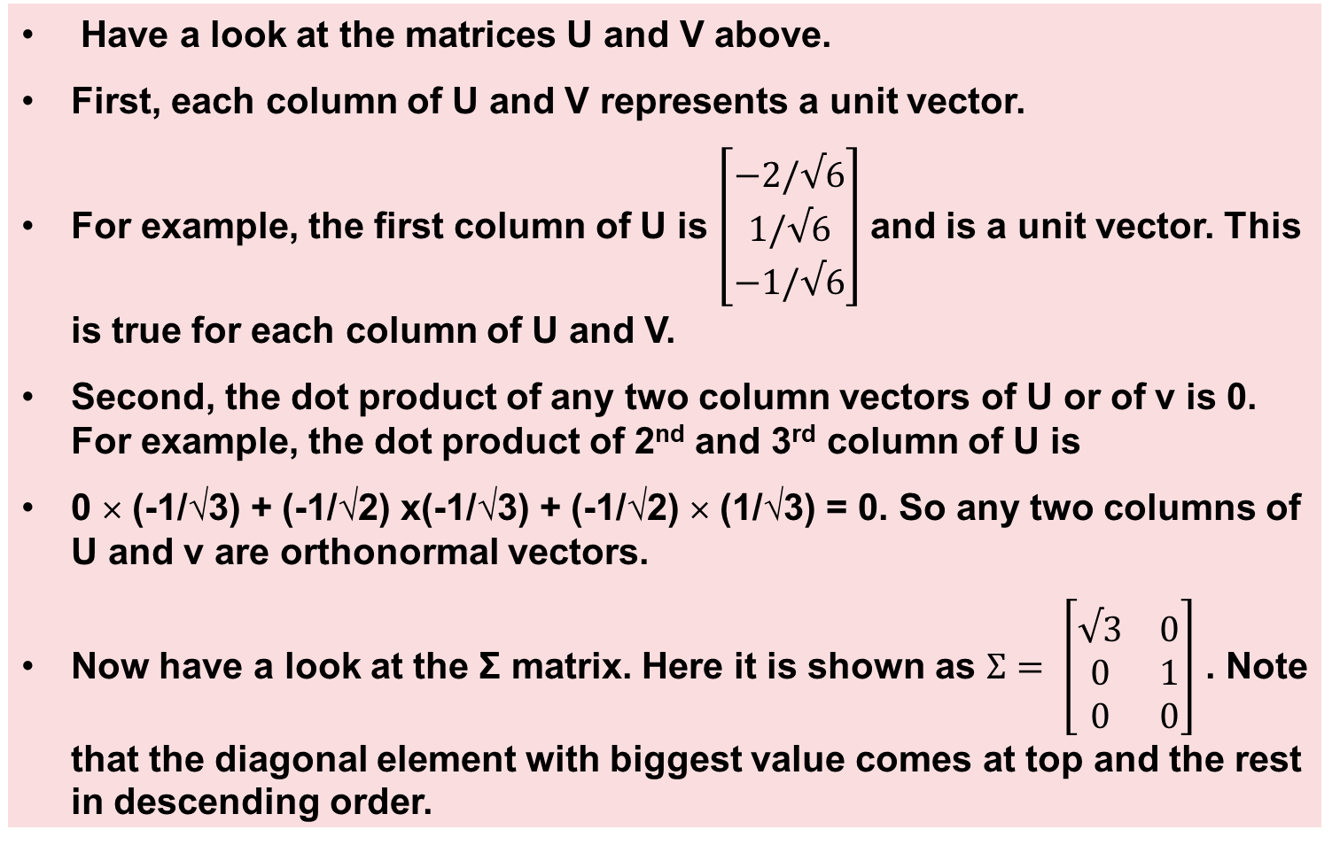
SVD -- 3
Have a look at the matrices U and V above.
First, each column of U and V represents a unit vector.
For example, the first column of U is $\left[\begin{matrix}−2/√6 \\ 1/√6 \\ −1/√6\end{matrix}\right]$ and is a unit vector. This is true for each column of U and V.
Second, the dot product of any two column vectors of U or of v is 0. For example, the dot product of 2nd and 3rd column of U is
0 × (-1/√3) + (-1/√2) x(-1/√3) + (-1/√2) × (1/√3) = 0. So any two columns of U and v are orthonormal vectors.
Now have a look at the Ʃ matrix. Here it is shown as $Ʃ= \left[\begin{matrix}√3 & 0 \\ 0 & 1 \\ 0 & 0\end{matrix}\right]$ . Note that the diagonal element with biggest value comes at top and the rest in descending order.
Python Programming: Problem Solving, Packages and Libraries

Slide 113
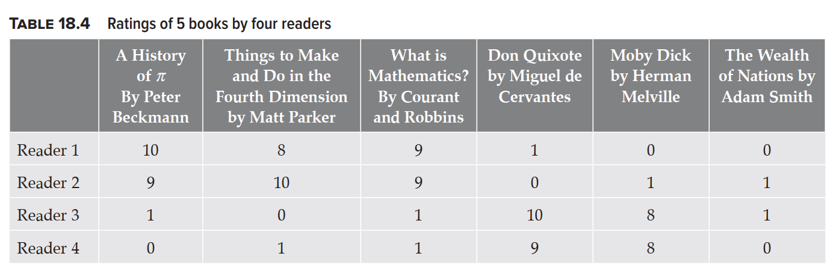
Using SVD for dimension reduction -- 1
The example below explains how SVD works.
In Table 18.4, 4 readers are represented in rows, i.e., Reader 1 to Reader4.
Further the columns of this table are five books.
Each entry in the table shows how each reader rates each book.
Notice that:
The first 3 books are related to maths, while the 4th and 5th books are related to literature. Book number 6 is of economics so unrelated to maths or literature.
Also note that the first 2 readers seem to have a choice for maths books while reader 3 and 4 seem to prefer literature books.
Python Programming: Problem Solving, Packages and Libraries

Slide 114
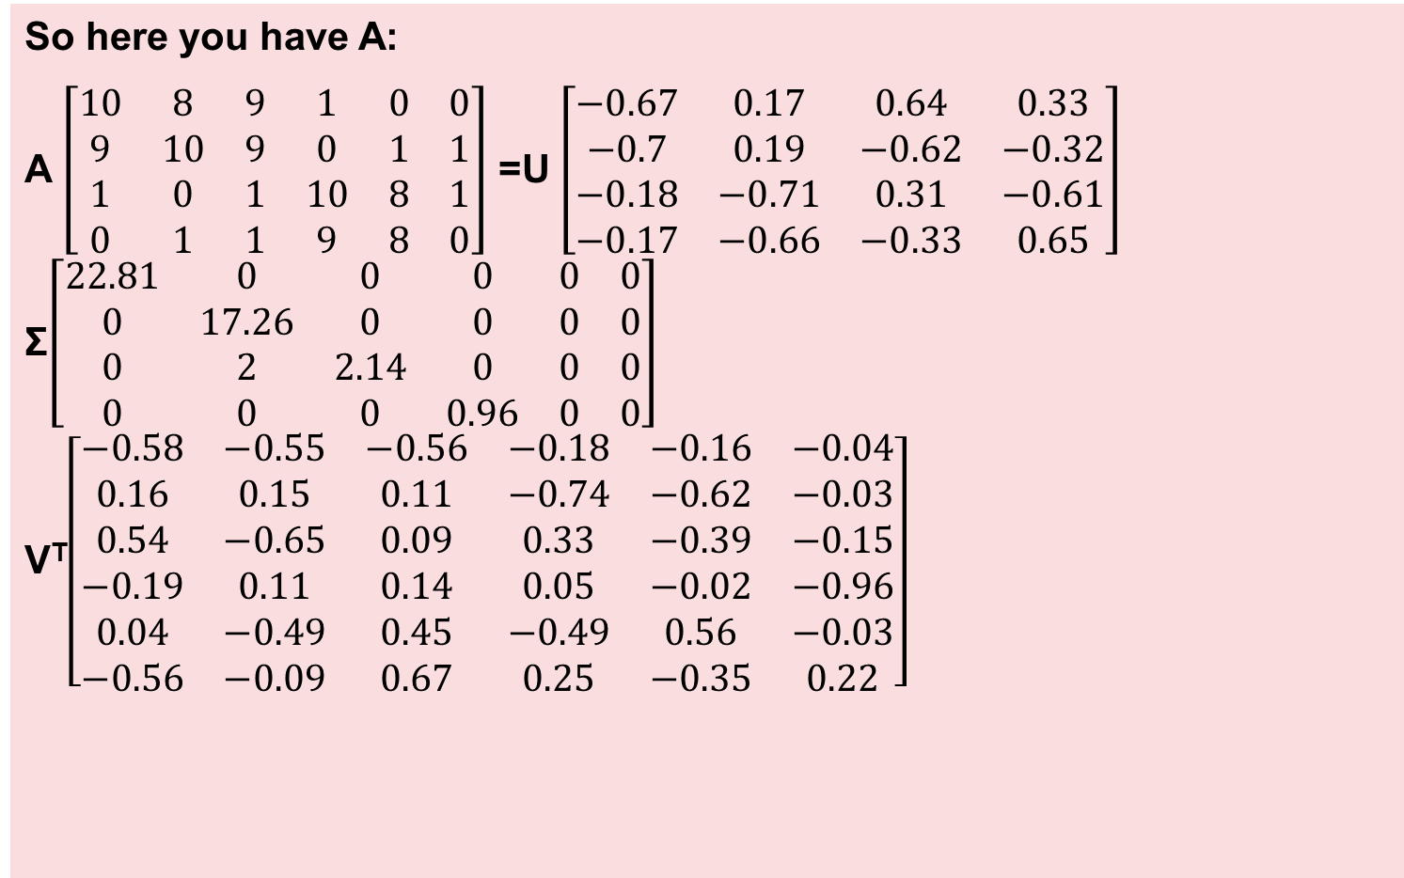
Using SVD for dimension reduction -- 2
So here you have A:
A $\left[\begin{matrix}10 & 8 & 9 & 1 & 0 & 0 \\ 9 & 10 & 9 & 0 & 1 & 1 \\ 1 & 0 & 1 & 10 & 8 & 1 \\ 0 & 1 & 1 & 9 & 8 & 0\end{matrix}\right]$ =U $\left[\begin{matrix}−0.67 & 0.17 & 0.64 & 0.33 \\ −0.7 & 0.19 & −0.62 & −0.32 \\ −0.18 & −0.71 & 0.31 & −0.61 \\ −0.17 & −0.66 & −0.33 & 0.65\end{matrix}\right]$ Ʃ$\left[\begin{matrix}22.81 & 0 & 0 & 0 & 0 & 0 \\ 0 & 17.26 & 0 & 0 & 0 & 0 \\ 0 & 2 & 2.14 & 0 & 0 & 0 \\ 0 & 0 & 0 & 0.96 & 0 & 0\end{matrix}\right]$ V^{T}$\left[\begin{matrix}−0.58 & −0.55 & −0.56 & −0.18 & −0.16 & −0.04 \\ 0.16 & 0.15 & 0.11 & −0.74 & −0.62 & −0.03 \\ 0.54 & −0.65 & 0.09 & 0.33 & −0.39 & −0.15 \\ −0.19 & 0.11 & 0.14 & 0.05 & −0.02 & −0.96 \\ 0.04 & −0.49 & 0.45 & −0.49 & 0.56 & −0.03 \\ −0.56 & −0.09 & 0.67 & 0.25 & −0.35 & 0.22\end{matrix}\right]$
Python Programming: Problem Solving, Packages and Libraries

Slide 115
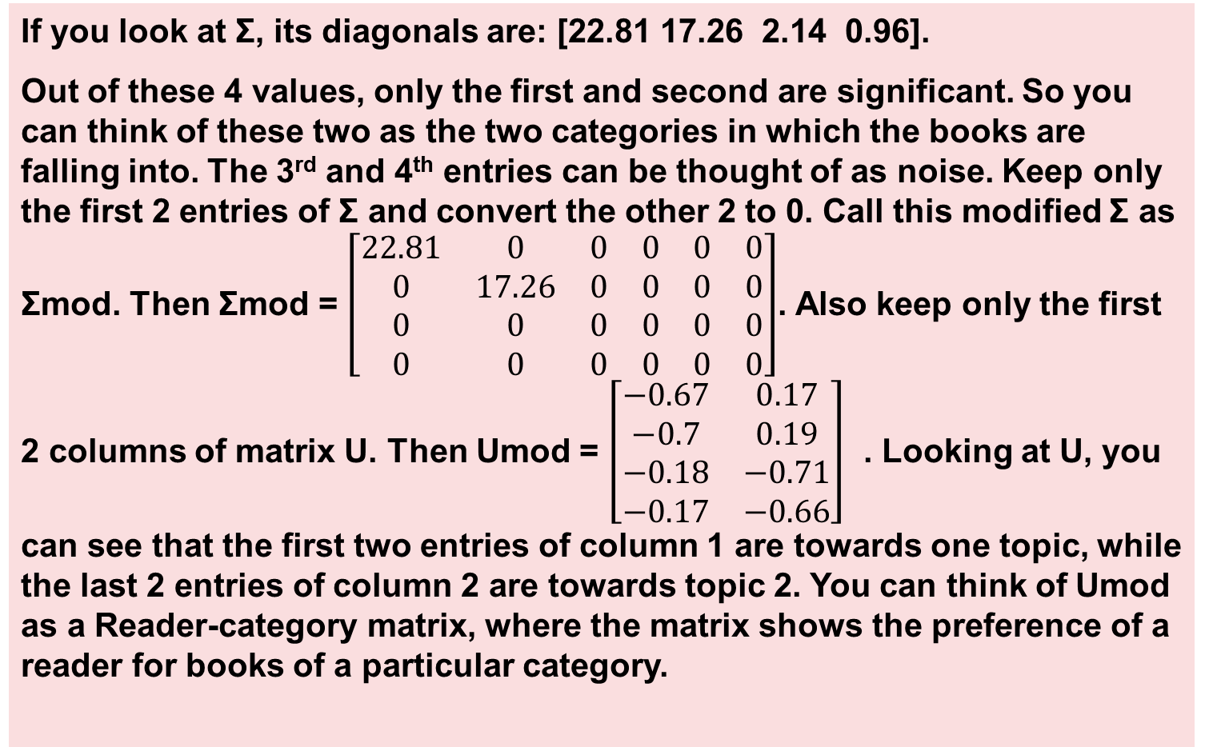
Using SVD for dimension reduction -- 3
If you look at Ʃ, its diagonals are: [22.81 17.26 2.14 0.96].
Out of these 4 values, only the first and second are significant. So you can think of these two as the two categories in which the books are falling into. The 3rd and 4th entries can be thought of as noise. Keep only the first 2 entries of Ʃ and convert the other 2 to 0. Call this modified Ʃ as Ʃmod. Then Ʃmod = $\left[\begin{matrix}22.81 & 0 & 0 & 0 & 0 & 0 \\ 0 & 17.26 & 0 & 0 & 0 & 0 \\ 0 & 0 & 0 & 0 & 0 & 0 \\ 0 & 0 & 0 & 0 & 0 & 0\end{matrix}\right]$. Also keep only the first 2 columns of matrix U. Then Umod = $\left[\begin{matrix}−0.67 & 0.17 \\ −0.7 & 0.19 \\ −0.18 & −0.71 \\ −0.17 & −0.66\end{matrix}\right]$ . Looking at U, you can see that the first two entries of column 1 are towards one topic, while the last 2 entries of column 2 are towards topic 2. You can think of Umod as a Reader-category matrix, where the matrix shows the preference of a reader for books of a particular category.
Python Programming: Problem Solving, Packages and Libraries

Slide 116
Using SVD for dimension reduction -- 4
You can think of V^{T}mod as a category-book matrix.
The first row represents the category of Maths books while the second row represents the category of Literature books.
So the first three books belong more to the category Maths while 4th and 5th books belong more to the Literature category.
Note that the 6th book does not fall in any particular category.
So you can say that:
The U matrix represents the Reader-Category relationship
The V matrix represents the Category-Books relationship.
The Ʃ matrix represents the relative abundance/ strength of each category.
Python Programming: Problem Solving, Packages and Libraries

Slide 117
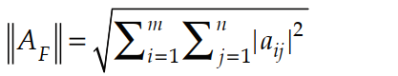
Using SVD for dimension reduction -- 5
You may reconstruct the original matrix from the modified matrices. Reconstruction means finding a matrix
Y = Umod⋅Ʃmod ⋅V^{T}mod.
Then:
Y = -0.670.17-0.70.19-0.18-0.71-0.17-0.66 . 22.810017.26. -0.58-0.55-0.56-0.18-0.16-0.040.160.150.11-0.74-0.62-0.03
If you do the above calculation, you will get:
Y-> [[9.31 8.85 8.84 0.53 0.54 0.5 ]
[9.66 9.18 9.16 0.45 0.48 0.52]
[0.53 0.49 1.03 9.82 8.25 0.53]
[0.51 0.47 0.97 9.2 7.73 0.5 ]]
You can see that matrix Y is very similar to original Matrix A.
You can compare these two matrices by taking their Frobenius norm.
The Frobenius norm of a matrix of dimensions m × n is given by:
Python Programming: Problem Solving, Packages and Libraries

Slide 118
Script to implement SVD
1 2 3 4 5 6 7 8 9 10 11 12 13 14 15 16 17 18 19 20 21 22 23 24 25 26 27 28 29 30 31 32 33 34 35 | from scipy import linalg from numpy import array, dot, shape, diag, zeros A = array([[10, 8, 9, 1, 0, 0], [9, 10, 9, 0, 1, 1], [1, 0, 1, 10, 8, 1], [0, 1, 1, 9, 8, 0],]) # 1---Create SVD of matrix A and convert S from 1_d array to matrix--- #1(a)---SVD of A ie A = U.S.Vt U, S, Vt = linalg.svd(A) print('U->', U) print('S->', S) print('Vt->', Vt) print(type(S)) # 1(b) ---Create Sm ie matrix from linear 1-D array S---- M,N = A.shape Sm = linalg.diagsvd(S,M,N) print('Sm->', Sm) #2 Modify Vt to have 2 rows. Modify S to be 2x2. Modify Y to have 2 columns S2 = Sm[:2, :2] Vt2 = Vt[:2, :] U2 = U[:, :2] print('Vt2->', Vt2) # Confirm Vt2 has 2 rows print('S2->', S2) # Confirm S2 is 2 x 2 print('U2->', U2)# Confirm U2 has 2 columns #3------- Reconstruct Y = U2.S2.Vt2 --- #3(a)----X is an intermediate dot product S2.Vt2 X = S2.dot(Vt2) #3(b)-----Y = ((U2.(S2.Vt2)) ie Y = U2.X ----- Y = U2.dot(X) print('Y->', Y) #4---Compare original matrix A to matrix Y using Frobenius norm Frob_Y = linalg.norm(Y) print('Frobenius norm of Y->', Frob_Y) Frob_A = linalg.norm(A) print('Frobenius norm of A->', Frob_A)
Python Programming: Problem Solving, Packages and Libraries

Slide 119
PANDAS
The complete PPT on Numpy/ Scipy (In pdf format) is available at:-
https://github.com/ag999git/Book-Python-Programming-Problem-Solving-Packages-and-Libraries/blob/master/PPT-notes-as-pdf/Ch-20-pandas-Open-Source-Data-Analysis-and-Manipulation-Tool.pdf
Python Programming: Problem Solving, Packages and Libraries

Slide 120

Pandas - - Learning Objectives
Python Programming: Problem Solving, Packages and Libraries

Slide 121
Need for a library like Pandas
Pandas is streamlined for data representation. This is especially true for data stored in files or available on a web resource.
Pandas has a number of methods for input/output operations. It can directly load data in various formats like csv, html and json and therefore can easily do data analysis on data in various formats.
Pandas also has a number of built-in features for data filtering.
The pandas library is basically Python’s answer to the statistical analysis capabilities of the R programming language.
If you want to pursue a course in data science or machine learning, then pandas is a very helpful library.
Python Programming: Problem Solving, Packages and Libraries

Slide 122
Various data structures in Pandas
There are basically three types of data structures in pandas: Series, DataFrame and Panel.
Series is a one-dimensional array with a label. It can hold data of almost any type including strings, numbers and Python objects. You can visualize Series as a column of data, such as observations on a single variable.
DataFrame is a two-dimensional (2D) data structure whose axes have labels. The two dimensions can hold data of different types. DataFrame can be thought of as similar to an Excel spread sheet. DataFrame is the most commonly used pandas object.
Panel is a container for three-dimensional data. It can have heterogeneous data. A panel can be thought of as a container for DataFrames. A panel has three axis. Axis0 (also called items) represents the individual dataframes contained in the panel. Axis1 (also called major_axis) represents the row index of each individual dataframe and Axis2 (Also called minor_axis) represents the columns for each of the individual dataframes.
Python Programming: Problem Solving, Packages and Libraries

Slide 123

We will talk only about DataFrame - - 1
DataFrame is the most widely used data structure of pandas.
This is because for reading tables and csv files, one generally needs a 2D object.
Further, all the spread sheets and text files are read as DataFrame, therefore it is a very important data structure of pandas.
One can understand a DataFrame by looking at Table 20.1.
Now in Table 20.1, each row can be thought of as a list. For example, the data for Earth could be represented as [Earth, 5.97, 12756, 24.0, 149.6]. Or the data for Earth could also be represented as Earth → [5.97, 12756, 24.0, 149.6] where Earth is the index of the list. Further you could represent the data as five columns, i.e., [Planet, Mass, Dia, Len_day, Dist_from_sun]. But in case you want to use the first column as index of each row then you need only four columns, i.e., [Mass, Dia, Len_day, Dist_from_sun].
Python Programming: Problem Solving, Packages and Libraries

Slide 124

DataFrame - - 2
You can represent the entire table above as a list of lists. Table 20.2 shows two tables giving each of the two possible formats. In the first table, the index is automatically generated by pandas and starts from 0. In the second table, you have to explicitly provide the names of each item in the index.
You may use the above data to create DataFrame. You can do it in two ways:
First: You may create a data frame where the name of the planet will be a part of the list and the index of each row then will be 0 to 3.
Second: You may create a list where the planet name will not be part of the list but will be the index of each list.
Python Programming: Problem Solving, Packages and Libraries

Slide 125
Example code for creating a DataFrame object - - 1
Method 1:-
Here a DataFrame object is created which has a “list of lists” of 4 planets.
The point to note here is that the index of each inner list is from 0 to 3
1 2 3 4 5 6 7 8 9 10 | import numpy as np import pandas as pd # my_data is a list of lists # Each inner list represents one row my_data = [['Mercury', 0.330, 4879, 4222.6, 57.9], ['Venus', 4.87, 12104, 2802.0, 108.2], ['Earth', 5.97, 12756, 24.0, 149.6], ['Mars', 0.642, 6792, 24.7, 227.9]] df1 = pd.DataFrame(data = my_data) print(df1)
11 12 13 14 15 16 | # OUTPUT--- 0 1 2 3 4 0 Mercury 0.330 4879 4222.6 57.9 1 Venus 4.870 12104 2802.0 108.2 2 Earth 5.970 12756 24.0 149.6 3 Mars 0.642 6792 24.7 227.9
Python Programming: Problem Solving, Packages and Libraries

Slide 126
Example code for creating a DataFrame object - - 2
Method 2:- You can modify the above script as follows:
Make the names of planets as index. So remove the names of planets from the list of lists.
Make a list of names of names of planets. Use this list as index to the DataFrame object.
Make a list of headers for each column and use this list for columns.
The modified script is as follows:
1 2 3 4 5 6 7 8 9 10 11 12 13 14 15 | import numpy as np import pandas as pd # my_data is a list of lists # Each inner list represents one row my_data = [[0.330, 4879, 4222.6, 57.9], [4.87, 12104, 2802.0, 108.2], [5.97, 12756, 24.0, 149.6], [0.642, 6792, 24.7, 227.9]] # Give data for index my_idx = ['Mercury', 'Venus', 'Earth', 'Mars'] # Give data for columns my_col = ['Mass', 'Dia', 'Day_len', 'Dist_sun'] df1 = pd.DataFrame(data = my_data, index = my_idx, columns = my_col) print(df1)
16 17 18 19 20 21 | # OUTPUT--- Mass Dia Day_len Dist_sun Mercury 0.330 4879 4222.6 57.9 Venus 4.870 12104 2802.0 108.2 Earth 5.970 12756 24.0 149.6 Mars 0.642 6792 24.7 227.9
Python Programming: Problem Solving, Packages and Libraries

Slide 127
Selecting a particular “row” or “column” of a dataFrame object
You can always select and print a particular row, i.e., index or column of a DataFrame object. The following script selects column “Mass” and row “Venus”:
1 2 3 4 | #print column Mass print(df1['Mass']) # Print row Venus print(df1.loc['Venus'])
5 6 7 8 9 10 11 12 13 14 15 16 17 | # OUTPUT--- Column Mass-> Mercury 0.330 Venus 4.870 Earth 5.970 Mars 0.642 Name: Mass, dtype: float64 Row Venus-> Mass 4.87 Dia 12104.00 Day_len 2802.00 Dist_sun 108.20 Name: Venus, dtype: float64
Python Programming: Problem Solving, Packages and Libraries

Slide 128
Using Boolean conditions for items in a column of a DataFrame object
You can test for data in a particular column, row wise using Boolean selection.
For example the following script uses the condition df1.Mass > 1 to check whether the Mass of a particular planet is greater than 1 or not.
1 2 | # Test for a condition on a given column of the DataFrame object print(df1.Mass > 1)
3 4 5 6 7 8 | # OUTPUT--- Mercury False Venus True Earth True Mars False Name: Mass, dtype: bool
Python Programming: Problem Solving, Packages and Libraries

Slide 129
Using Boolean conditions for items in a row of a DataFrame object
You can also select rows which meet a particular condition in a given column.
Suppose you want only those rows (i.e., those planets) whose Mass > 1, then you can write the code as follows:
1 2 | # Select only those rows where Mass > 1 print(df1[df1.Mass > 1])
3 4 5 6 | # OUTPUT--- Mass Dia Day_len Dist_sun Venus 4.87 12104 2802.0 108.2 Earth 5.97 12756 24.0 149.6
Python Programming: Problem Solving, Packages and Libraries

Slide 130
Creating a DataFrame from list or from list of lists
You can easily create a DataFrame object either from a list or from a list of lists (i.e., a nested list). An example script is as follows:
1 2 3 4 5 6 7 8 9 | import pandas as pd L1 = ['a', 'b', 'c'] L2 = [['Row1', 'a', 1], ['Row2', 'b', 2], ['Row3', 'c', 3]] # Use list to create a 1D DataFrame object df1 = pd.DataFrame(data = L1, index = [1, 2, 3], columns = ['Letters']) print(df1) # Use list of lists to create 2D DataFrame object df2 = pd.DataFrame(data = L2, columns = ['RowNumb', 'char', 'number']) print(df2)
10 11 12 13 14 15 16 17 18 | # OUTPUT--- Letters 1 a 2 b 3 c RowNumb char number 0 Row1 a 1 1 Row2 b 2 2 Row3 c 3
Python Programming: Problem Solving, Packages and Libraries

Slide 131
Using the key: value pair of a Dictionary to create a DataFrame object
In the previous example, you had provided a list of lists to the parameter data to create a DataFrame object.
You can also create a DataFrame by using a dictionary of equal-length list.
The key of the dictionary becomes the column names and the value of the dictionary must be a list and each of the list item becomes an entry in the column.
This is shown in the following code:
1 2 3 4 5 6 | import pandas as pd some_data = {'Name': ['Anil', 'Babita', 'Charu', 'Dimple'], 'Age': [20, 21, 22, 23], 'Sex': ['M', 'F', 'F', 'F']} my_df = pd.DataFrame(some_data) print(my_df)
7 8 9 10 11 12 | # OUTPUT--- Name Age Sex 0 Anil 20 M 1 Babita 21 F 2 Charu 22 F 3 Dimple 23 F
Python Programming: Problem Solving, Packages and Libraries

Slide 132
Using pandas to open csv files read_csv() method - - 1
The pandas library has a method read_csv(). This method can accept a number of parameters. The signature of the method is as follows:
1 2 3 4 5 6 7 8 9 10 11 14 15 16 17 18 | Signature: pd.read_csv(filepath_or_buffer, sep=',', delimiter=None, header='infer', names=None, index_col=None, usecols=None, squeeze=False, prefix=None, mangle_dupe_cols=True, dtype=None, engine=None, converters=None, true_values=None, false_values=None, skipinitialspace=False, skiprows=None, nrows=None, na_values=None, keep_default_na=True, na_filter=True, verbose=False, skip_blank_lines=True, parse_dates=False, infer_datetime_format=False, keep_date_col=False, date_parser=None, dayfirst=False, iterator=False, chunksize=None, compression='infer', thousands=None, decimal=b'.', lineterminator=None, quotechar='"', quoting=0, escapechar=None, comment=None, encoding=None, dialect=None, tupleize_cols=False, error_bad_lines=True, warn_bad_lines=True, skipfooter=0, skip_footer=0, doublequote=True, delim_whitespace=False, as_recarray=False, compact_ints=False, use_unsigned=False, low_memory=True, buffer_lines=None, memory_map=False, float_precision=None) Docstring: Read CSV (comma-separated) file into DataFrame Returns:- DataFrame or TextParser
Python Programming: Problem Solving, Packages and Libraries

Slide 133
read_csv() method - - 2
There are too many parameters to this method read_csv(). Only the important ones are discussed here. They are as follows:
filepath_or_buffer: You need to provide a file name here.
sep: This stands for the seperator. The default is comma, i.e., “,”.
header: The default behaviour is to infer Row number(s) to use as the column names. However, you may specify the row number (as an integer) to be used as header.
index_col: Here you can specify the column to be used as row label of the DataFrame.
nrows: Here you can specify (as an integer), the number of rows to read (useful for reading few lines of a very large file).
Encoding: Encoding to use for UTF when reading/writing
Python Programming: Problem Solving, Packages and Libraries

Slide 134
Using read_csv() method to read a file from disk - - Example
You may first create a csv file (you may create your own csv file). A Notepad++ is used here. The data is as follows:
Letter, Fruit, Animal, Place
A, Apple, Ant, Amritsar
B, Berry, Bat, Bangalore
C, Cherry, Cat, California
The name of the file is letters.csv and the absolute path is: “C:\Users\DS\Documents\planets.csv”
The code on Jupyter is as follows:
1 2 3 | import pandas as pd myData = pd.read_csv("C:\Temp\letters.csv", encoding = "ISO-8859-1") print(myData)
It has a very large number of parameters out of which only the first, i.e., filepath has to be compulsorily provided.
The two common encoding schemes are:
utf-8(For encoding in Unicode.)
latin1/ ISO-8859-1=(ISO/IEC 8859 is divided into several parts. The most widely used part is latin-1 and it covers most western European Languages.)
Python Programming: Problem Solving, Packages and Libraries

Slide 135

Using read_csv() on Jupyter
The script along with its output on Jupyter is shown in Figure 20.3.
Python Programming: Problem Solving, Packages and Libraries

Slide 136
Using pandas to read html files
You can use the read_html() method of pandas to get a list of dataframes. Consider the following code:
1 2 3 4 5 6 7 8 9 10 11 12 13 14 15 | import pandas as pd def getData(url): try: dat = pd.read_html(url) print(dat) print(type(dat)) except: print("Something went wrong") #Valid url u1 = 'https://nssdc.gsfc.nasa.gov/planetary/factsheet/' #Invalid url u2 = 'https://xxxxyyyyzzzz' getData(u1) getData(u2)
Line 3–9: You have created a function getData(url). Inside the function you can check for possible error. Whenever you are scraping data from the Internet, it is a good practice to handle possible errors because a number of things can go wrong on the Internet.
Line 11: u1 is a valid url which gives planets data.
Line 13: This is an invalid url and will therefore throw an exception which will be caught in line 8-9.
Python Programming: Problem Solving, Packages and Libraries

Slide 137
Reading/Writing to JSON files
In the following script, a JSON object from a DataFrame object is created. For this you may use a to_json(‘path’) method, specifying the path to the file where the json object is to be saved.
1 2 3 4 5 6 7 8 9 10 11 12 13 14 15 16 17 18 | import pandas as pd import json # Create a pandas dataframe from the planet data used earlier. df = pd.DataFrame([[0.330, 4879, 4222.6, 57.9], [4.87, 12104, 2802.0, 108.2], [5.97, 12756, 24.0, 149.6], [0.642, 6792, 24.7, 227.9]], index = ['Mercury', 'Venus', 'Earth', 'Mars'], columns = ['Mass', 'Dia', 'Day_len', 'Dist_sun']) #Save the dataframe as a JSON object to file testJ.json df.to_json(r'C:\Temp\testJ.json') # You can open the testJ.json file and load data to a JSON object called jData with open(r'C:\Temp\testJ.json', 'r') as jFile: jData = json.load(jFile) print(jData) print('Convert json data into key:value pair') for key, val in jData.items(): print(str(key) + ':' + str(val))
Python Programming: Problem Solving, Packages and Libraries

Slide 138
Open Source software movement:- the two broad categories
The "Anything Goes" Licenses
These place very few restrictions on what can be done with the code, including using the code in proprietary derivative works. They require only attribution in a specified manner. The most widely-used licenses of this type are:
BSD-style
MIT/X11-style
Apache Software License, version 2
The Copyleft (so-called "viral") Licenses
These allow distribution, modification, and re-use of the code, but insist that any derivative works be distributed under the same terms. Widely-used licenses of this type are:
GPLv3 (GNU General Public License, version 3)
AGPLv3 (Affero GPL, version 3)
Source:- http://wiki.civiccommons.org/Choosing_a_License/

Slide 139
Open Source software movement:- which license to use?
So Which License Should I Choose?
It depends on what effect you want.
If you’re comfortable with companies coming along and using the code in possibly proprietary products (that they will then try to sell back to you), then just use the BSD-style license from “anything goes” category.
On the other hand,
if you don’t want proprietary derivatives from other parties appearing, then use a copyleft license: the GPLv3 or the AGPLv3.
The latter is preferable mainly if you want to ensure that anyone offering hosted instances of the software on a network makes their source code available (with their modifications, if any).
Source:- http://wiki.civiccommons.org/Choosing_a_License/

Slide 140
Open source software: References/ suggested reading
Suggested reading:-
The Cathedral and the Bazaar: Musings on Linux and Open Source by an Accidental Revolutionary (See:- https://en.wikipedia.org/wiki/The_Cathedral_and_the_Bazaar)
Free as in Freedom:- Richard Stallman's Crusade for Free Software:- By Sam Williams (See:- https://www.oreilly.com/openbook/freedom/)
For difference between free vs open source, read:- https://www.gnu.org/philosophy/open-source-misses-the-point.html
If you want to read the story of Calibre which is an open source project by an Indian, see:- https://opensourceforu.com/2020/01/calibre-the-worlds-best-open-source-e-book-reader-is-made-by-an-indian/
Rebel Code: Linux and the Open Source Revolution:- See Wikipedia page at:- https://en.wikipedia.org/wiki/Rebel_Code

Slide 141
VECTOR SPACE MODEL
AND
GENSIM (TOPIC MODELING)

Slide 142

Vector Space Model

Slide 143

Vectors in N-dimension space

Slide 144


How do you bring together the 2 vectors? This can be explained with help of an example. Suppose you have 2 vectors say $\vec{A}$ and $\vec{B}$. Suppose by training you want to bring $\vec{A}$ closer to $\vec{B}$. If you add a fraction of $(\vec{B}$-$\vec{A}$ ) say $δ(\vec{B}$-$\vec{A}$ ) to $\vec{A}$, then it can be shown that the new vector, i.e., $\vec{A}$ + $δ(\vec{B}$-$\vec{A}$ ) will be closer to $\vec{B}$. This can be shown in Figure A4.3.

Slide 145

Gensim:- The Basics

Slide 146

Some important concepts in Gensim documentation are:
Corpus: A corpus is simply a collection of digital documents. During training of a “model”, you can use a corpus. Further this training is unsupervised.
Vector Space Model for Documents (VSM): VSM has been explained in an appendix. In Gensim, a VSM for a document is the “features” it contains. So the number of “features” that a document has are the number of “dimensions” of the vector space for the document.
Sparse vector representation: The concept of vector has already been explained. A concept which needs explanation is representation of a “sparse vector”. So there are two questions, i.e., What is a sparse vector? And how to represent it? These questions are best answered by an example. Suppose a document has 10 features (with feature ID 0 to 9) and is represented by a vector $\vec{A}$ = (0, 0, 0, 0, .3, .4, 0, 0, 0, .3)^{T}. This is a vector of 10 dimensions but only 3 of the 10 dimensions have a non-zero entry. (Note the superscript T indicates that in normal algebra a vector is represented as a “column”, however to save space, it is written in a row with a superscript of T to indicate a “transverse” of the row). The other 7 are 0. So the vector is “sparsely populated”. So you may represent the vector as ((4, 0.3), (5, 0.4), (9, 0.3)). So you have the index of the non-zero feature and the value of the non-zero feature.
Model: A model can be thought of as a transformation from one vector space to another. For example, if you convert a dictionary of say 10,000 words to a vector space with say 300 features, then the exact method by which you do this is your model.

Slide 147
A little bit about Open Source

Slide 148



Open Source software movement:- The cake analogy
The recipe of the cake is analogous to the source code of an application.
If someone gives you the cake but not its recipe, then you have the cake but do not know how to make it; you cannot modify it or change its recipe. This is equivalent to a closed source system.
However if you are given the recipe of the cake, it is an open source system. You can now make your own cakes or even the modify the recipe to serve your own needs
A baked cake without its recipe is like a closed source system

Slide 149

Open Source software movement:- The four freedoms
The freedom to run the program as you wish, for any purpose (freedom 0).
The freedom to study how the program works, and change it so it does your computing as you wish (freedom 1). Access to the source code is a precondition for this.
The freedom to redistribute copies so you can help others (freedom 2).
The freedom to distribute copies of your modified versions to others (freedom 3). By doing this you can give the whole community a chance to benefit from your changes. Access to the source code is a precondition for this.
Source:- https://www.gnu.org/philosophy/free-sw.html
GNU
Mascot

Slide 150
Open Source software movement:- Common license types
Commonly used Open source licenses:-
Apache License 2.0
BSD 3-Clause "New" or "Revised" license
BSD 2-Clause "Simplified" or "FreeBSD" license
GNU General Public License (GPL)
GNU Library or "Lesser" General Public License (LGPL)
MIT license
Mozilla Public License 2.0
Common Development and Distribution License
Eclipse Public License version 2.0
Source:- https://opensource.org/licenses

Slide 151

GitHub:-
Why you should use it

Slide 152

GitHub Basics - 1
Git is an open-source version control system that was started by Linus Torvalds
GitHub is a code hosting platform for version control and collaboration.
Repository:- Usually used to organize a single project. Repositories can contain folders and files, images, videos, spreadsheets, and data sets.
Branching is the way to work on different versions of a repository at one time.
Source:- https://guides.github.com/activities/hello-world/

Slide 153
GitHub Basics - 2
Forking – It is copying a repository from one user’s account to another. Suppose you want to modify a project, but don’t have write access to it.
Then you can
“fork” it. This enables you to take a project that you don’t have write access to and modify it under your own account.
If you make changes you’d like to share, you can send a notification called a “pull request” to the original owner.
That user can then, with a click of a button, merge the changes found in your repo with the original repo.
These three features – fork, pull request and merge – are what make GitHub so powerful.

Slide 154

A picture showing how GitHub works
How they work
Fork
Clone
Pull
Push
Pull request
Merged
Source:- https://levelup.gitconnected.com/how-to-sync-forked-repositories-using-git-or-github-2933e497fa16

Slide 155

GitHub Desktop
GitHub Desktop is an app.
It is a very helpful tool for beginner developers, and can also get work done faster.
To use it, you need to download it from https://desktop.github.com/ and install it. You also need to sign into your GitHub account. After that you can (1) create or (2) clone a repository.
Resource:-
For downloading/ installation and introduction, see:- https://help.github.com/en/desktop/getting-started-with-github-desktop/creating-your-first-repository-using-github-desktop
Another good source:- https://github.com/github/welcome-to-github-and-desktop

Slide 156







Thank You!
For any queries or feedback contact us at:
support.india@mheducation.com
1800-103-5875
www.mheducation.co.in
McGraw-Hi
156

Slide 157
Speaker
Anurag Gupta |
IPS Officer, Jharkhand
Thank You!
Purchase the latest edition of Python on Amazon. Kindle edition also available
Search with ISBN : 9789353168001
or Visit : https://bit.ly/PythonProgramming_AG

